Slide 1
21 cm cosmology and the BINGO radio telescope
Carlos Alexandre Wuensche
on behalf of the BINGO Collaboration
ca.wuensche@inpe.br
August 31, 2021

Slide 2
Plan of the lectures
21 cm cosmology
21 cm observations
the BINGO project

Slide 3
The BINGO Telescope
BAOs from Integrated Neutral Gas Observations

Slide 4
























BINGO - BAOs in Integrated Neutral Gas Observations
Visit us at https://bingotelescope.org

Slide 5





Our sponsors

Slide 6
Project management status (September 2021)
Most of the funding (> 60%) is already granted
  FAPESP: main funding agency.
  General coordination: Elcio Abdalla (IF/USP)
  Management team: C. A. Wuensche (INPE), Luciano Barosi (UFCG), Filipe Abdalla (UCL), Bin Wang (YangZhou Univ.)
BINGO construction proceeds…
  Major Project Review 2019 → green light to proceed to Phase 2.
  Road work and site preparation started January 2021
  Horn, transitions, polarizer, and magic tee prototypes successfully tested (2018 – 2021)
  Main receiver components (first stage LNAs and filters, secondary LNAs and filters) qualified (2020 – 2021)
  Receiver undergoing tests and integration to the digital backend at INPE
  First horn prototype coupled to a simple radiometer currently looking at the sky in Paraíba
  Optical design completed (2021)
  Engineering projects near completion
  Dish fabrication under discussion

Slide 7
The BINGO main science case
Measure BAOs on top of the 21 cm Hydrogen spectrum => intensity mapping in radio
Redshift interval BINGO will reach starts right after DE starts dominating the Universe => possible to set constraints on its properties
HI intensity mapping can be used as mass tracer, probing distortions in redshift space
Complementary to large optical surveys
Notes:
Acoustic waves imprinted on CMB 380,000 years after Big Bang
Acoustic scale D set by distance light travelled at that time
Known precisely from CMB power spectrum
D=147.4 ± 0.6 Mpc (from Planck results)
BAO scale imprinted on all matter in the Universe
Use as a “standard ruler”
Baryon oscillations seen in the CMB distribution can be observed in the spatial distribution of galaxies
The acoustic peak gives the ratio of the distances to z=.35 and z=1,100 to 4% fractional accuracy.
Absolute distance to z=0.35 is determined to 5% accuracy.
Co-moving sound horizon scale 149 h⁻¹ Mpc

Slide 8
Additional science with BINGO
(We are building an ultra-deep large-area spectral survey at 980-1260 MHz)
BAOs contain additional information about
  Matter density
  Redshift distortions
  Anisotropic BAOs…
Life history of hydrogen
Radio recombination lines
Galactic continuum
And, of course, FRBs, which will be delivered for free due to the nature of BINGO observational strategy

Slide 9
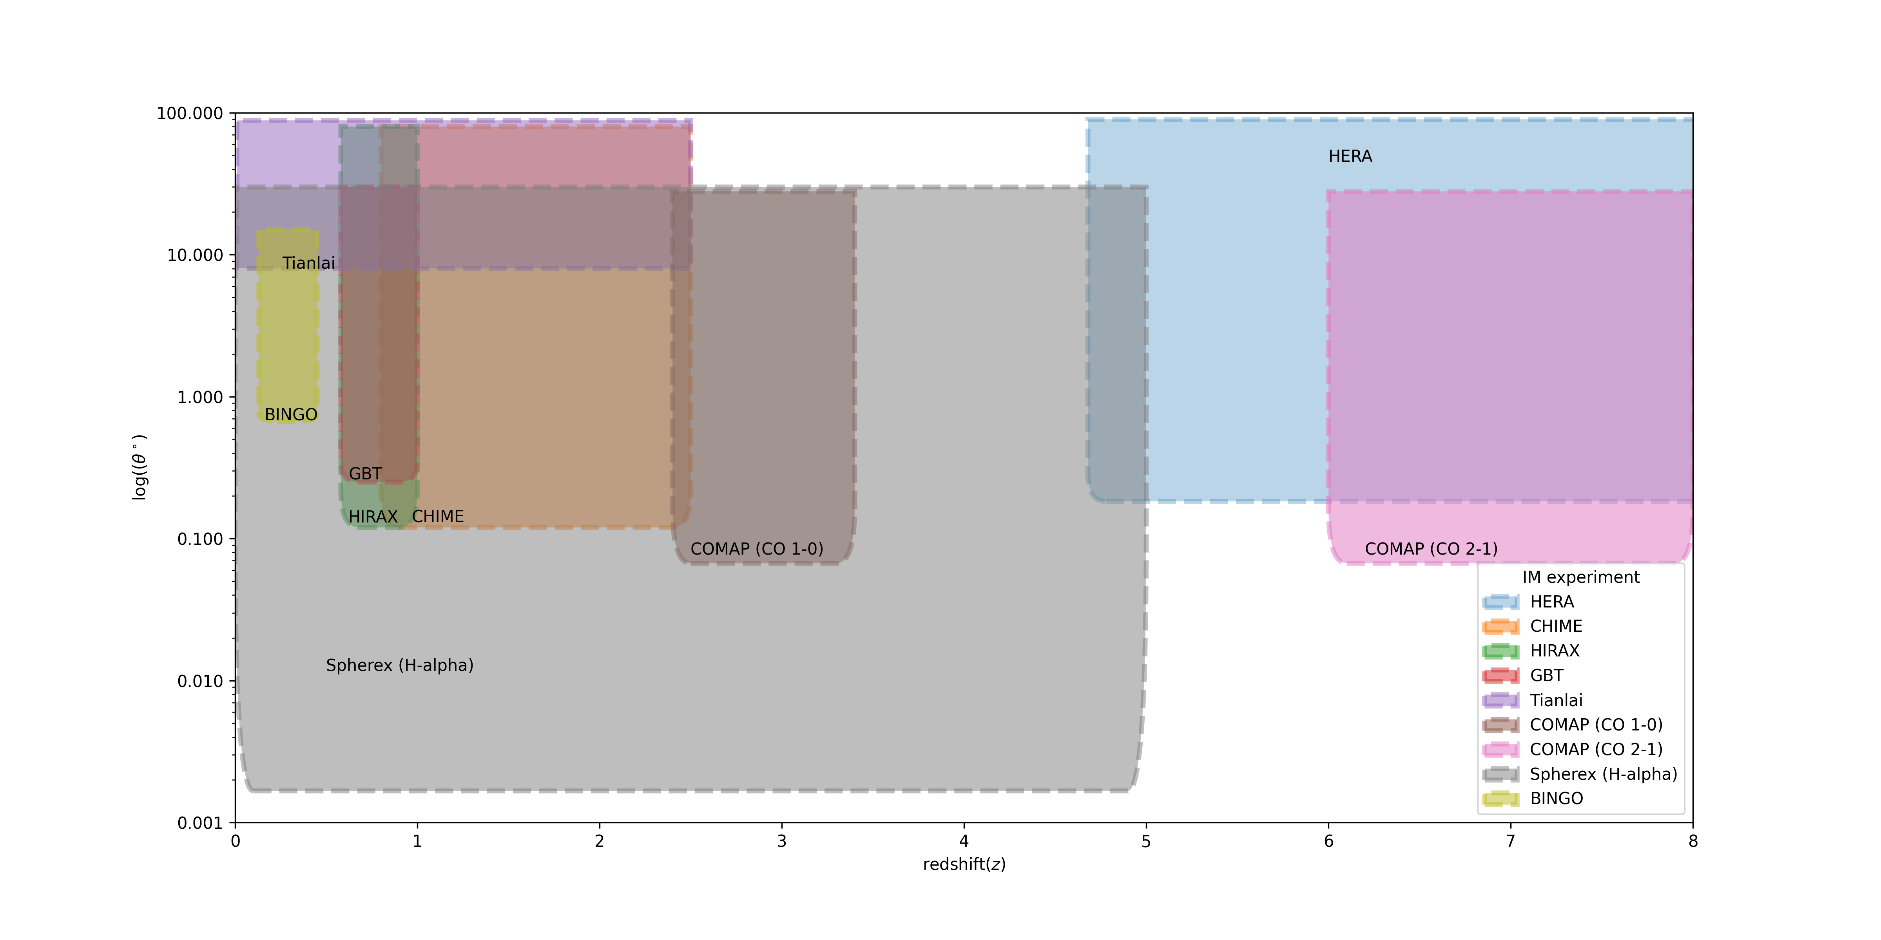
A survey of current and future experiments…
Source: The BINGO Collaboration

Slide 10
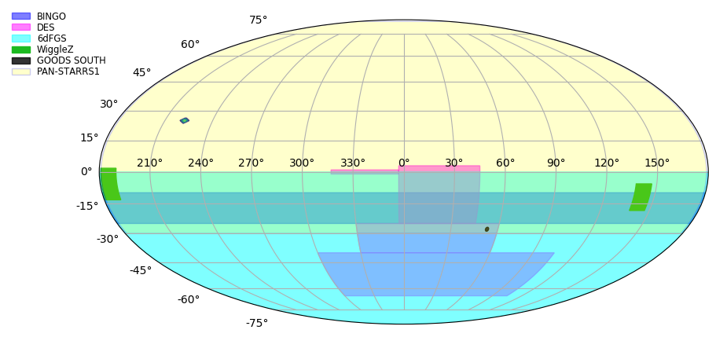
Sky coverage
Source: The BINGO Collaboration

Slide 11
LSST Cosmology map
LSST Cosmology map (simulated). arXiv:1708.04058, chap. 9, fig. 9.3.
BINGO coverage area in white

Slide 12
General BINGO pipeline information flow
From E. Merícia

Slide 13
Challenges (October 2021)
Large telescope: discussions ongoing with the company to produce the dishes
Large horns: fabrication process understood, discussions ongoing with the company to produce the horns
Calibration and stability: use colfets and a CW source as internal calibration. Noise and stability for both are under investigation
Receiver stability: has to be tested with internal cooling and later, under the hot environment temperature in Paraíba
Digital backend: SKARAB boards are the choice. Learning curve for their programming is not known yet, need to be integrated to the system in the lab
Optical design: optics simulations indicate very small distortions of the beams for the current horn array. Final horn positioning still to be determined. TBC during commissioning
Radio Frequency Interference → Mobile quiet zone has been already requested to the state authorities (both to State agencies and to ANATEL)

Slide 14
Accepted for publication - A&A
Replying to the referee - A&A

Slide 15
E. Abdalla et al. arXiv:2107.01633
FRB
Bispectrum
Minkowski functionals

Slide 16
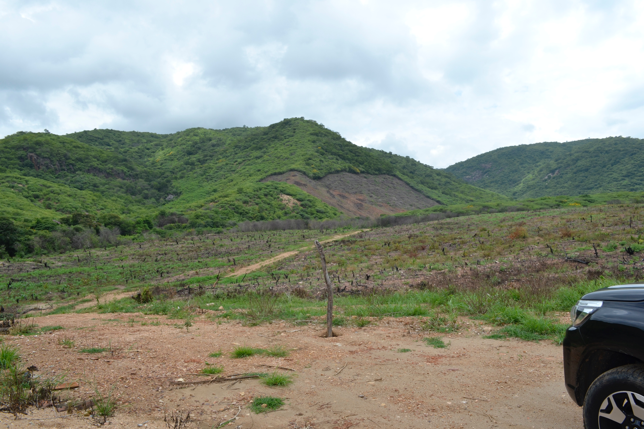
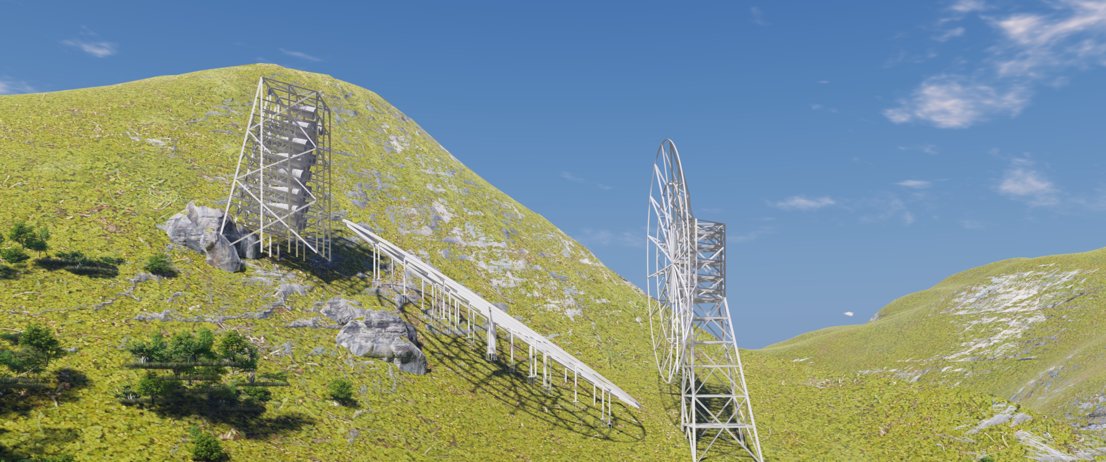
C. A. Wuensche et al. arXiv:2107.01634

Slide 17
The “FIDUCIAL” BINGO – Phase 1 (June 2021)
TELESCOPE INFORMATION
Site coordinates (vertex of the area)
7° 2' 27,6" S | 38° 16' 4.8" W
Site denomination: Serra da Catarina, Aguiar (PB)
Focal length (m) | 63.2
Primary major semi-axis (m) | 25.7
Primary minor semi-axis (m) | 20.0
Secondary major semi-axis (m) | 18.3
Secondary minor semi-axis (m) | 18.0
Primary area (m²) | 1620
Effective area (average, m²) | 600
Number of horns | 28
Telescope orientation | N-S
Central declination (deg.) | -15
RECEIVER INFORMATION
T_sys (K) | 70
Minimum frequency (MHz) | 980
Maximum frequency (MHz) | 1260
Frequency band (for 30 channels, MHz) | 9.33
Instrument noise (mK, 1 second) | 26.5
Instrument noise (mK, 1 second) | 26.5
Digital backend FFT channels | 2048
Sampling time (s) | 0.1
SURVEY INFORMATION
Beam resolution (FWHM, deg.) | 0.67
Total covered area (sqr deg) | 5300
Fixed wire-mesh parabolas
No moving parts
Transit telescope
Most components “off-the-shelf”
Guiding principle : simplicity !

Slide 18
V. Liccardo et al. arXiv:2107.01636

Slide 19
A. A. Costa et al. arXiv:2107.01639
Notes:
Fig. 12. 68% and 95% CL marginalized constraints for two interacting dark energy models with
Q proporcional a RHO_de and w < - 1 (top)
Q proporcional a RHO_dm (bottom)

Slide 20
J. Zhnag et al. arXiv:2107.01638
Notes:
Fig. 18. We show the angular power spectrum of HOD mocks (solid faint curves) comparing to the calculation of UCLCl code with linear calculation (dashed lines) and halofit nonlinear correction (dotted lines) in redshift space.
Red (orange, green, blue) lines show the result from 960 (1050, 1150, 1160) MHz to 970 (1060, 1160, 1260) MHz, middled at 965 (1055, 1155, 1255) MHz, which are amplified by 0.25 (0.5, 1, 2) times for better illustration.
HOD mock measurements are higher than the linear calculation, but lower than the halofit calculation at small scale.

Slide 21
F. Abdalla et al. arXiv:2107.01635

Slide 22
K. Fornazier et al. arXiv:2107.01637

Slide 23
Forthcoming papers
FRB data analysis (led by Marcelo Novaes)
Estimation of sensitivity to BAO signal (led by Camila Novaes)
Refining of foreground separation methods (led by Eduardo Mericia)
The BINGO receiver (led by Fred Vieira)
Cross-correlations with optical surveys
Other works in progress

Slide 24
Thank you!
Visit us at http://www.bingotelescope.org

Slide 25
NEXT STEPS

Slide 26
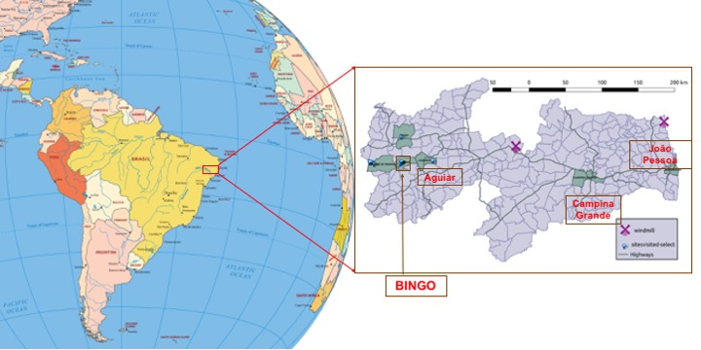
The BINGO location
Paraíba state

Slide 27
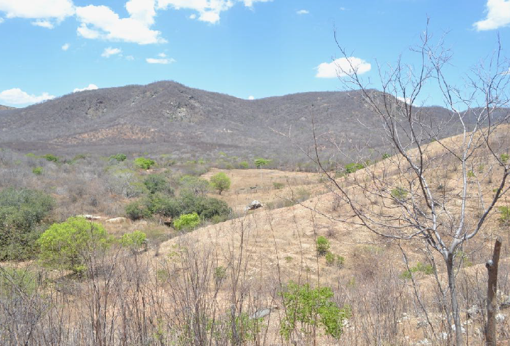
Serra da Catarina, Vale do Piancó (PB)
7° 2' 27,6" S; 38° 16' 4.8" W
Photo: M. Peel

Slide 28
Status as of March 01, 2021

Slide 29
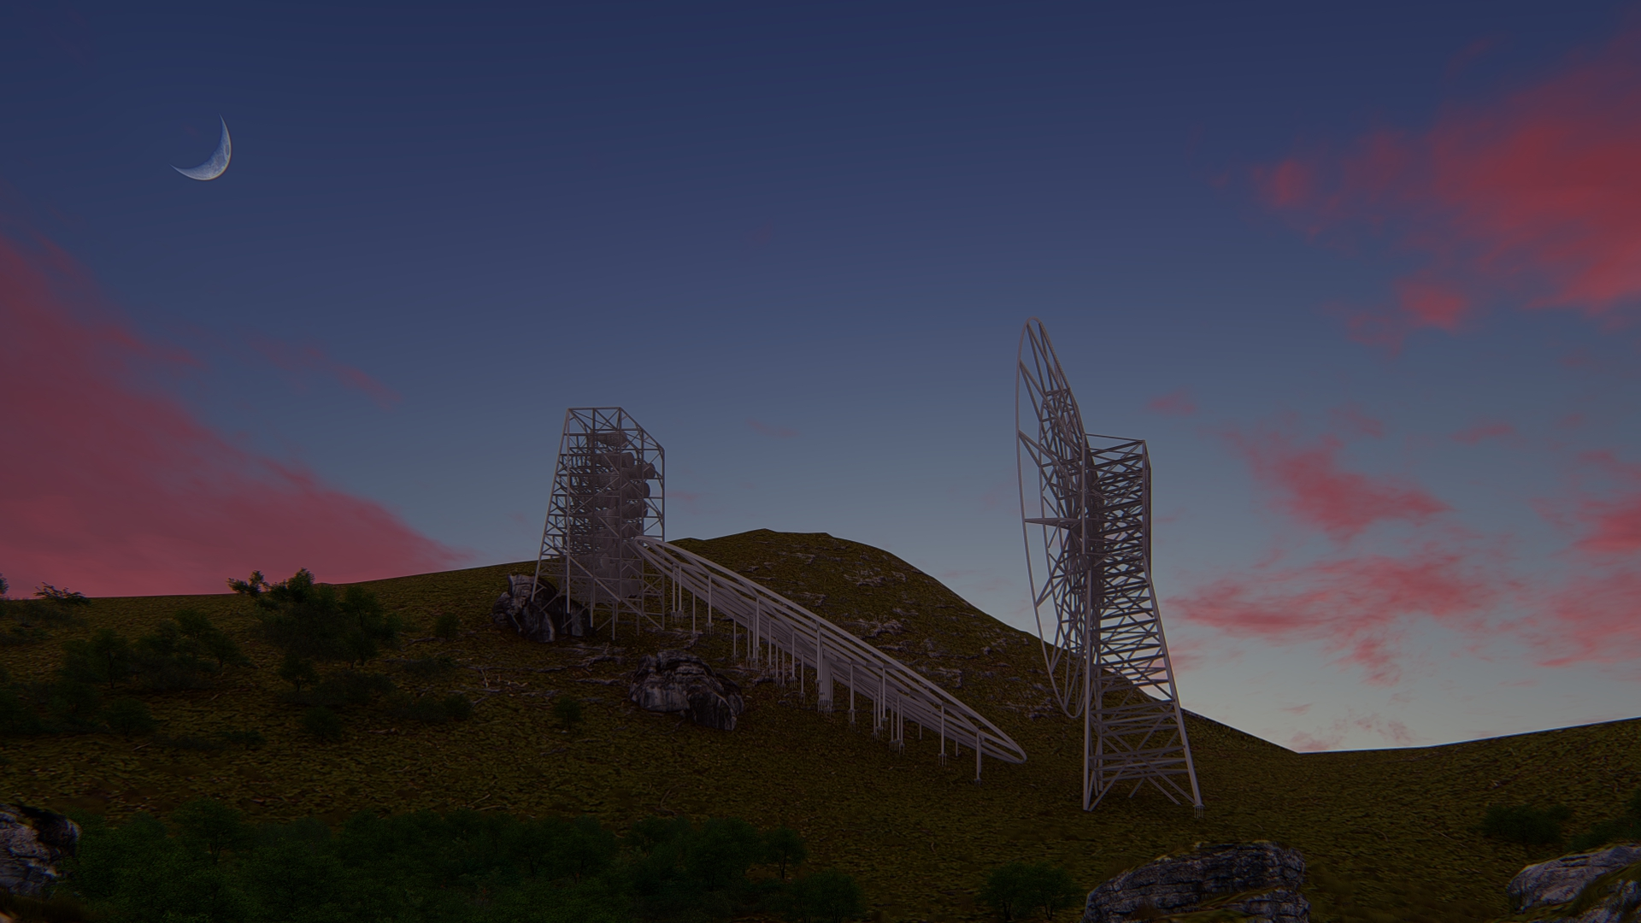
Artistic view – May 2021

Slide 30
The BINGO subsystems

Slide 31
Receiver prototype
Led by CAW

Slide 32
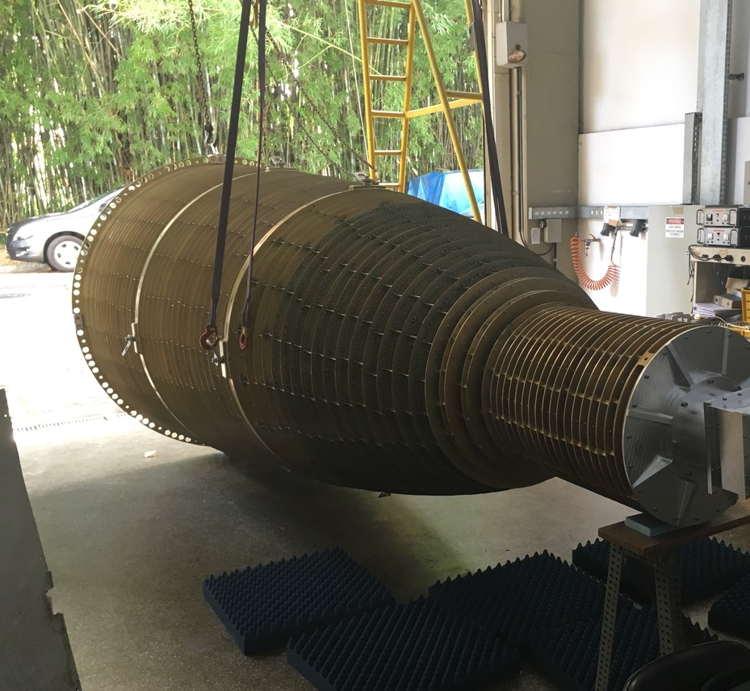
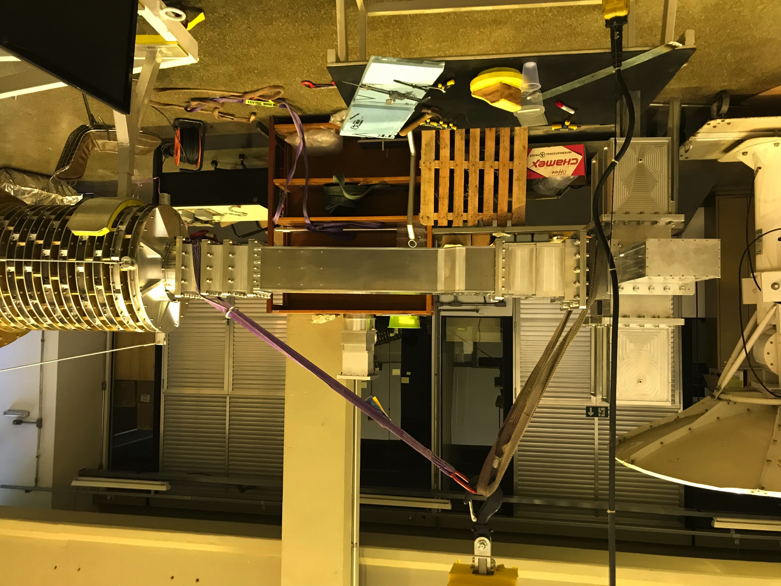
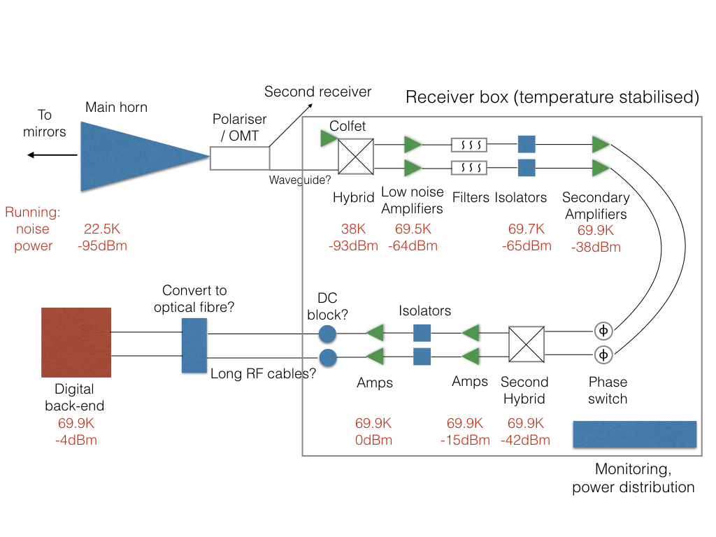
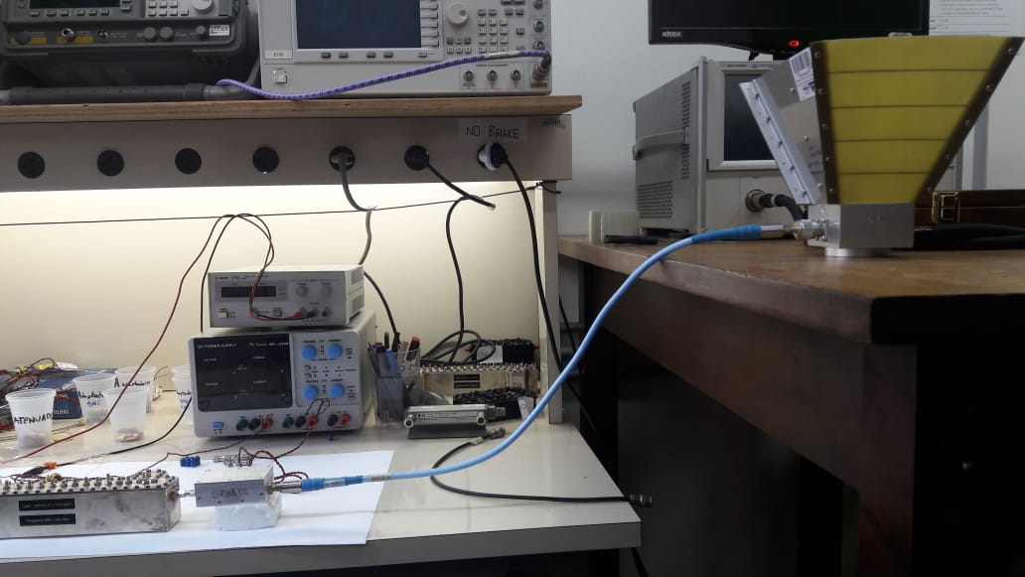
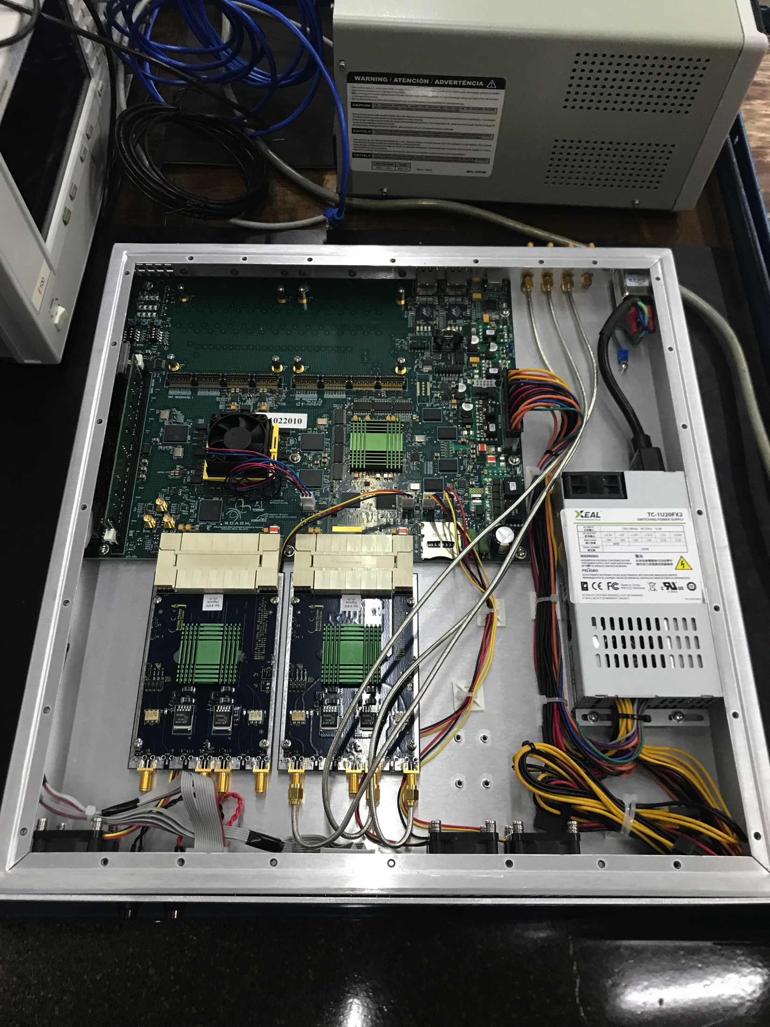
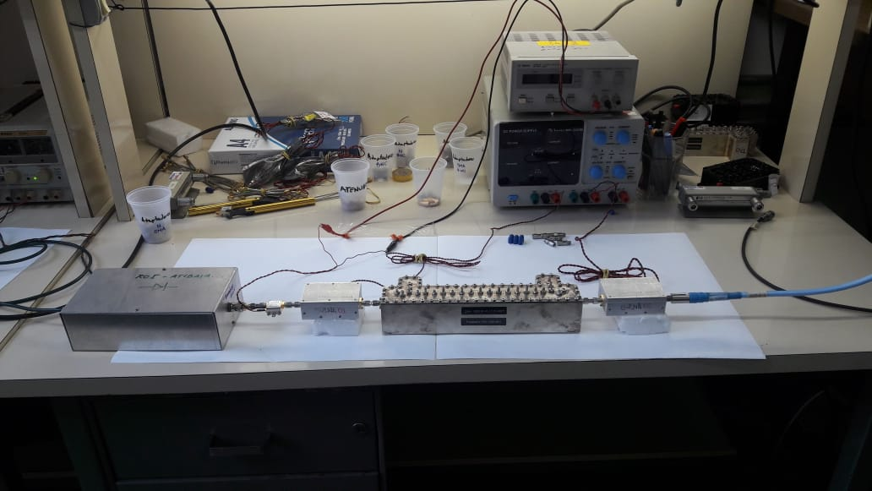
Notes:
The nominal BINGO receiver layout. A correlation receiver is used to amplfy the signals from a horn and a COLFET (acting as a reference signal). The horn, polarizers and first hybrid (magc tee) are shown more clearly in Fig. 3.1.

Slide 33
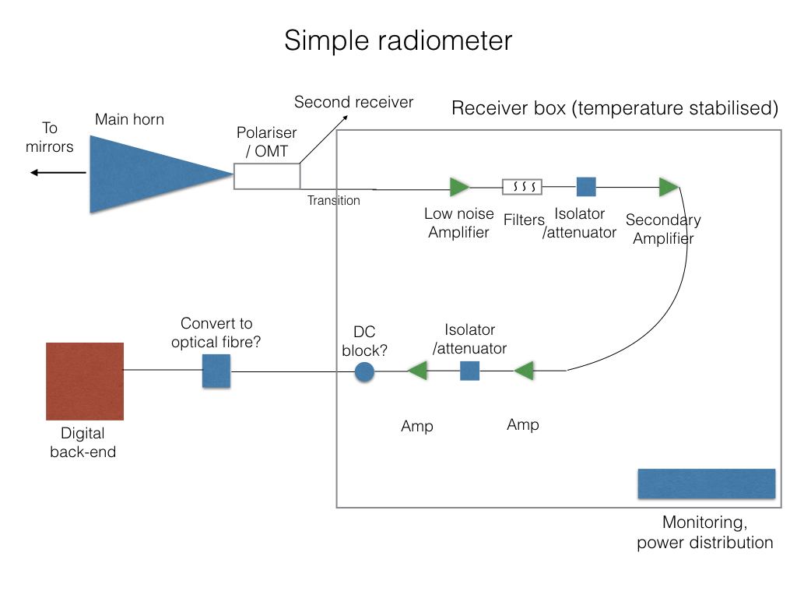
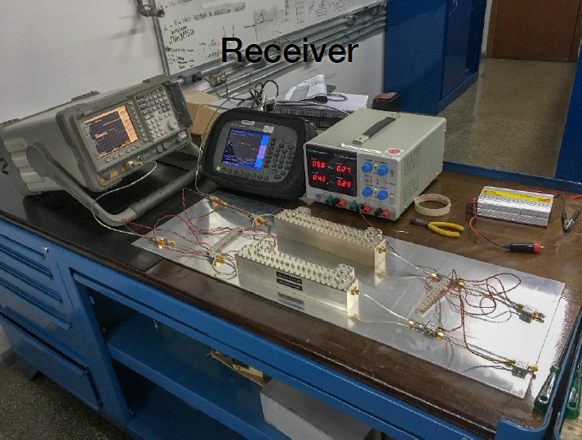
Receiver status
Desired: full orrelation receiver
Photo: M. Peel @ INPE’s lab
Notes:
The nominal BINGO receiver layout. A correlation receiver is used to amplfy the signals from a horn and a COLFET (acting as a reference signal). The horn, polarizers and first hybrid (magc tee) are shown more clearly in Fig. 3.1.

Slide 34
Horn & polarimeter status
Aluminum horns
  6060 T4 alloy
  Mass: ~ 400 kg
  Number of rings (sectors): 127
  Length: 4318 mm
  Mouth: 1900 mm
  Throat: 250 mm
Prototype construction
  Calfer (Brazil)
Polarimeters transitions and magic tees (aluminum)
  Mass: ~ 90kg,
Prototype construction
  Metalcard (Brazil)
EM project: Bruno Maffei (IAP, France)
  Contributions from Chris Radcliffe (Phase 2 Microwave, UK)
Mechanical project : Luiz Reitano (INPE, Brazil)

Slide 35
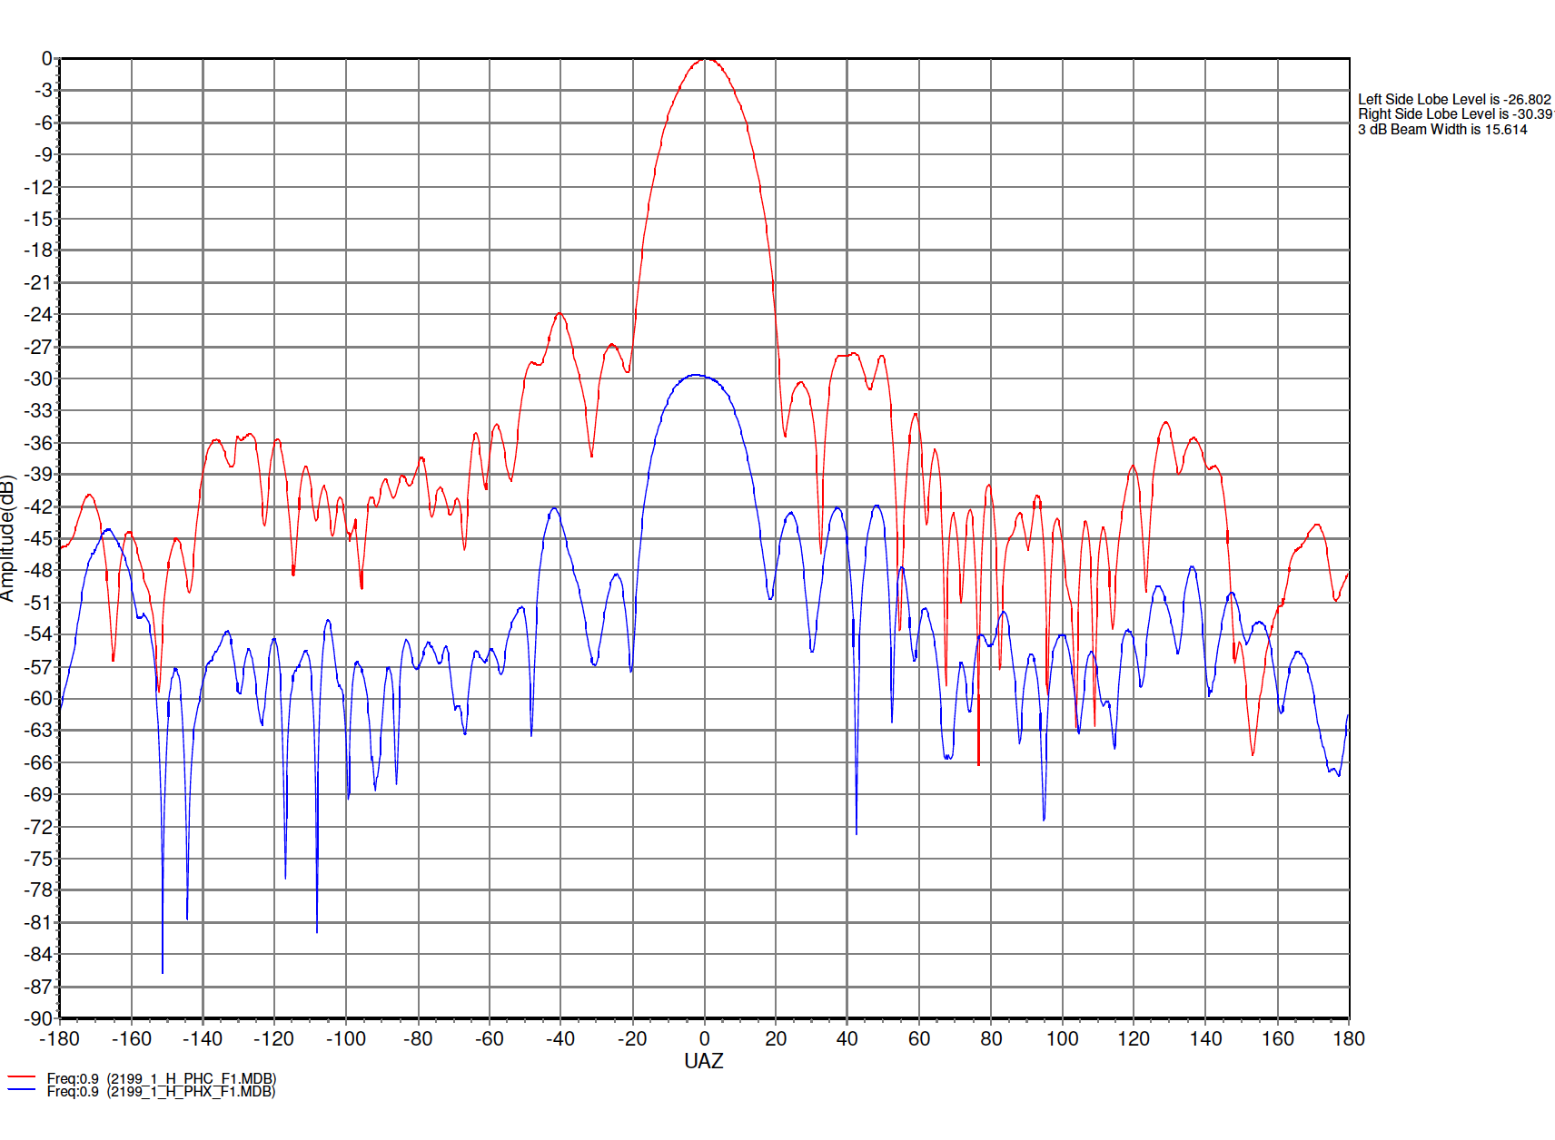
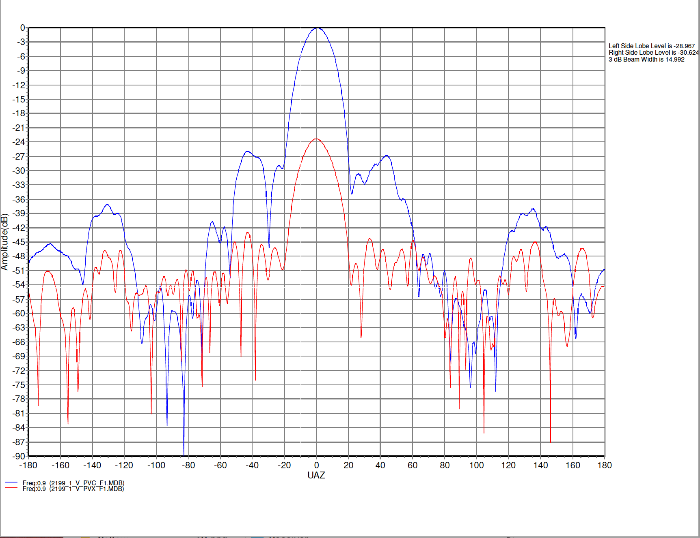
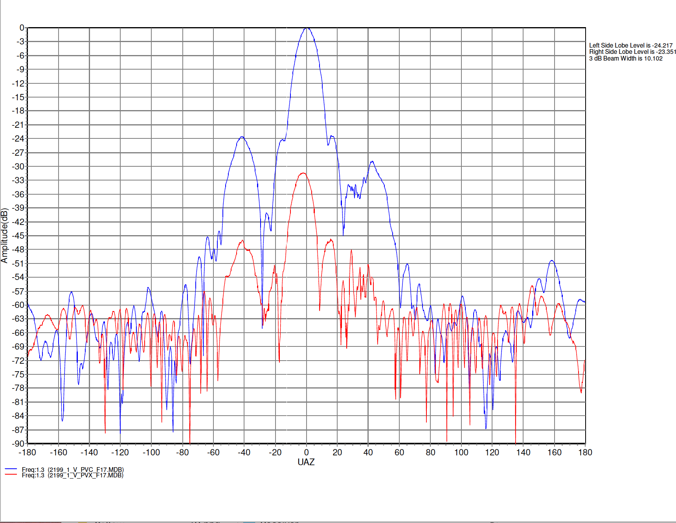
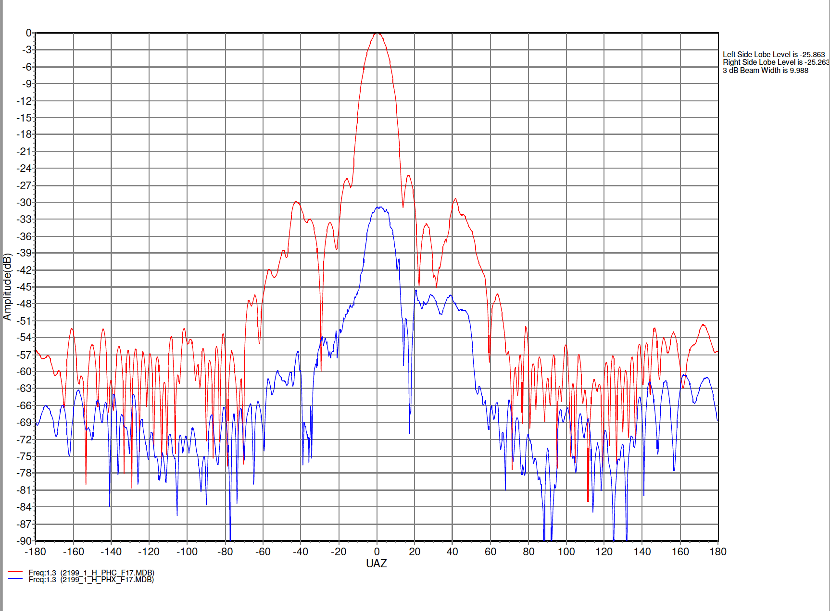
Horn testing results –polarization
900 MHz
VERTICAL
HORIZONTAL
1300 MHz

Slide 36
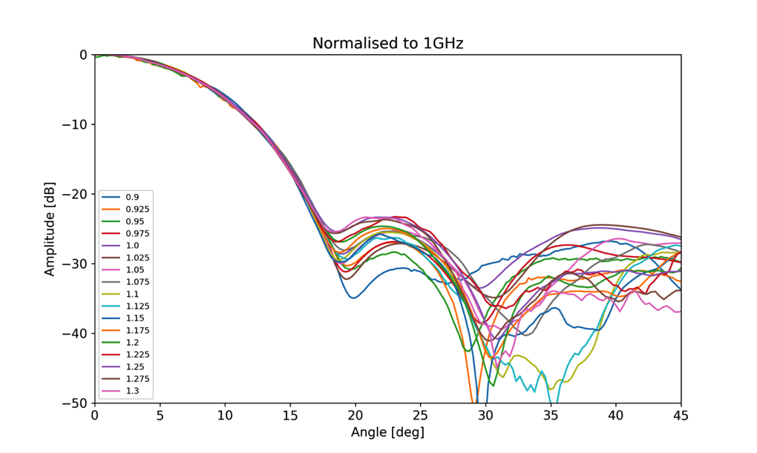
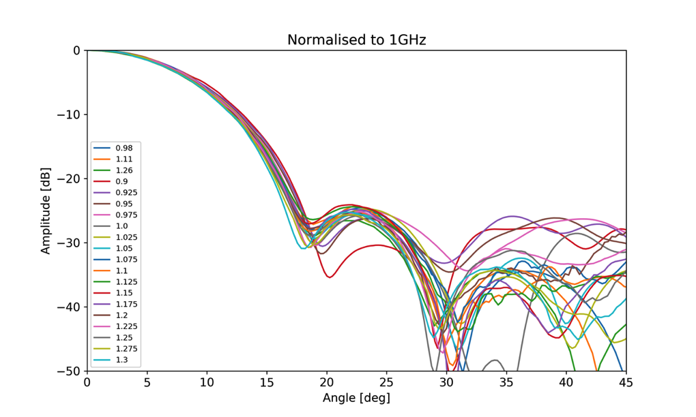
Horn testing results – Combination of all freqs.
Horizontal polarization
Vertical polarization
Wuensche et al. (arXiv:1911.13188)

Slide 37
Horn testing results
Wuensche et al. (arXiv:1911.13188)

Slide 38
Optical design
Coordinated by F. Abdalla, with original work from B. Maffei and I. Ferreira

Slide 39
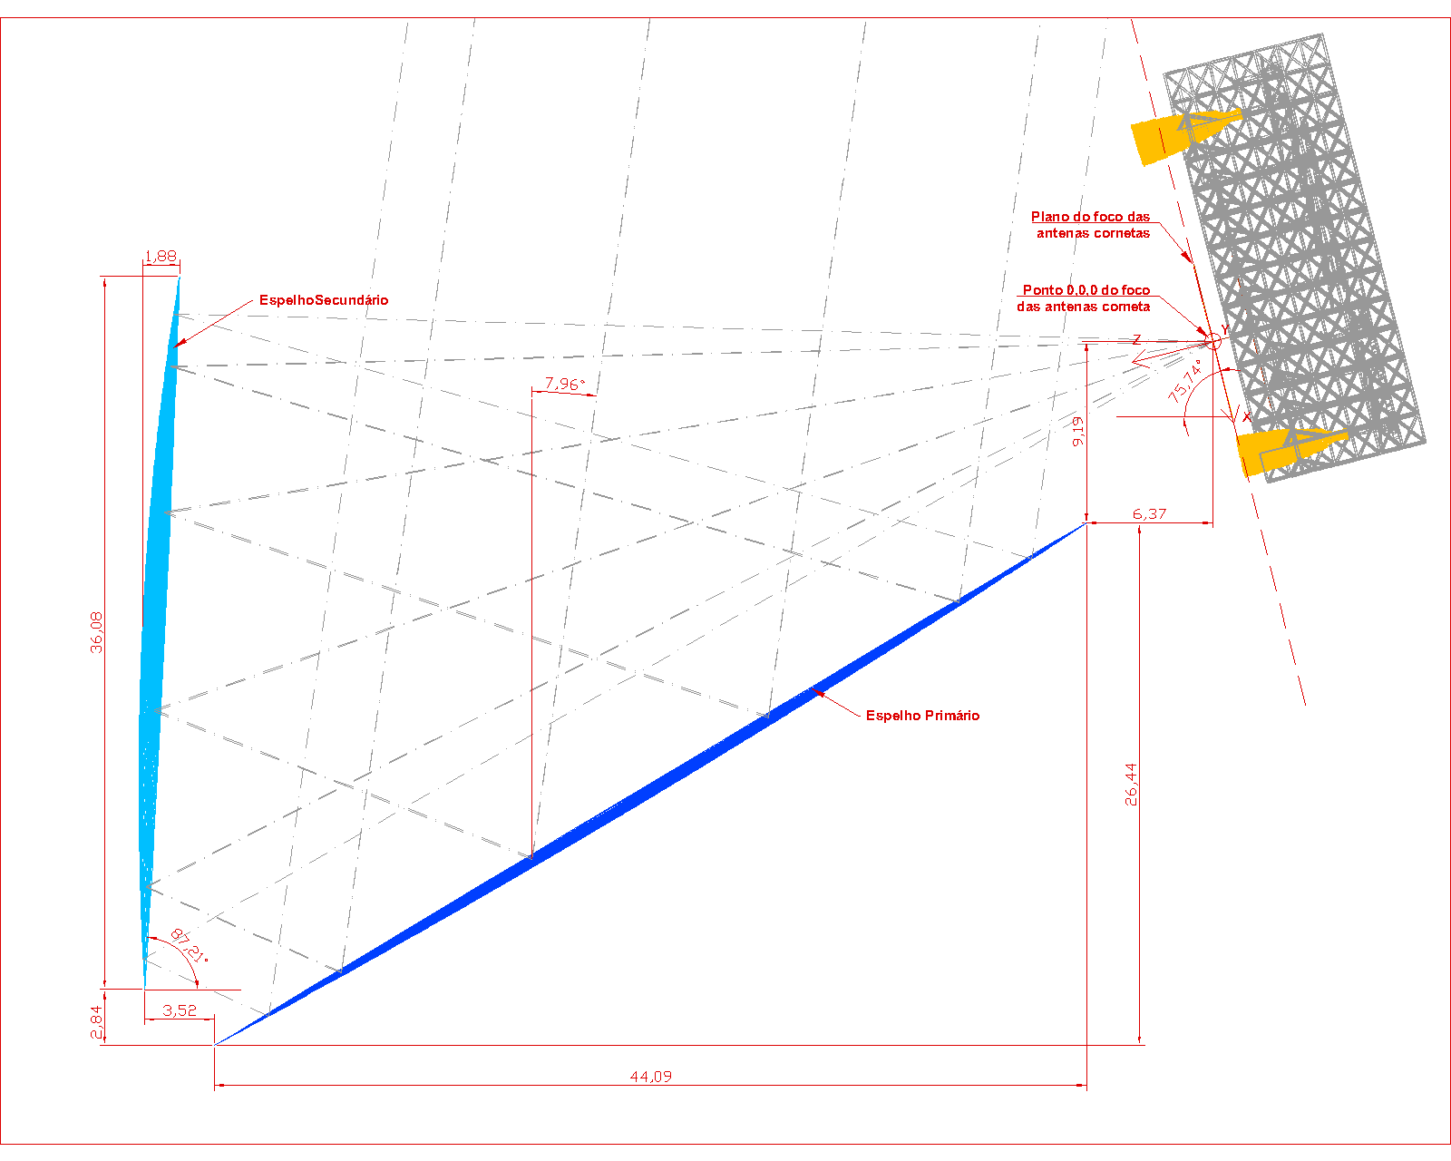
Sketch of 3-D model of optics
Horn array
(detectors)
Secondary mirror
Primary mirror
Lat: -7 deg
Source: BINGO Collaboration

Slide 40
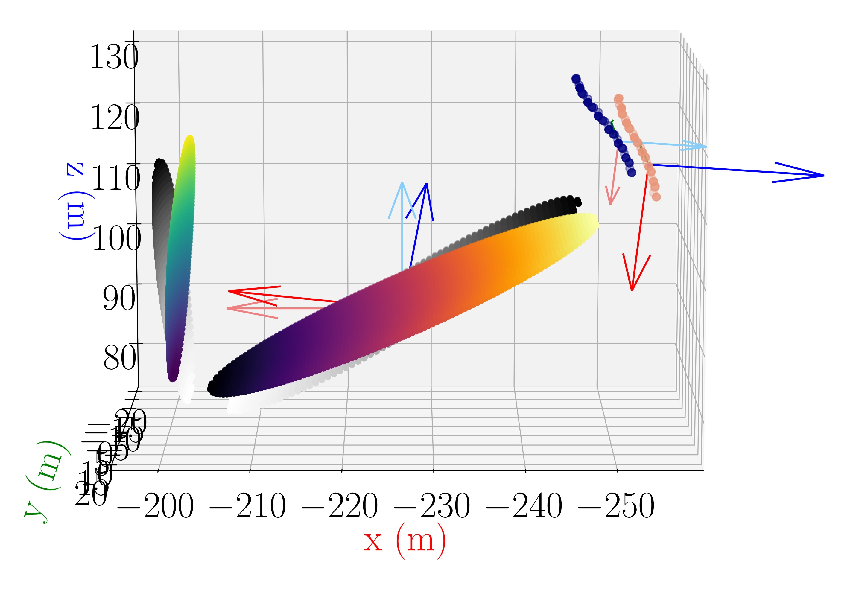

Slide 41
Primary dish
Source: Ponto de Apoio Engenharia

Slide 42
Secondary dish
Source: Ponto de Apoio Engenharia

Slide 43
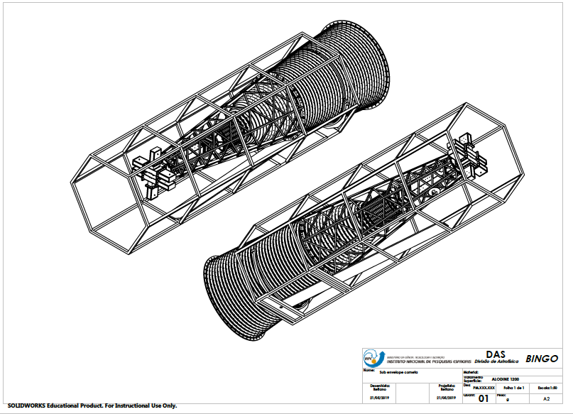
Source: BINGO Collaboration (L. A. Reitano)

Slide 44
Source: Ponto de Apoio Engenharia

Slide 45
Focal plane – 28 horns
Declination coverage: ~ 15.4 deg
Future upgrade to 56 horns

Slide 46
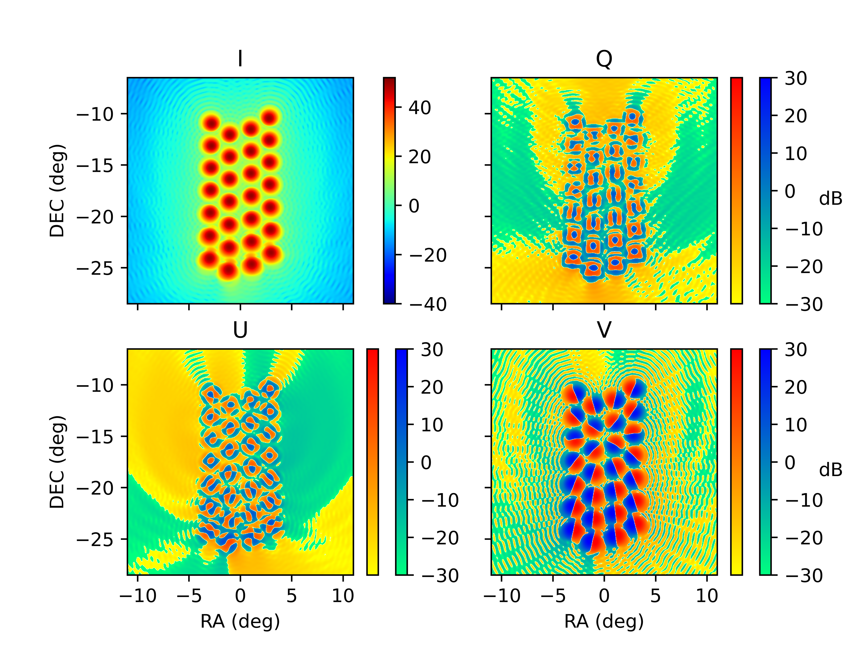
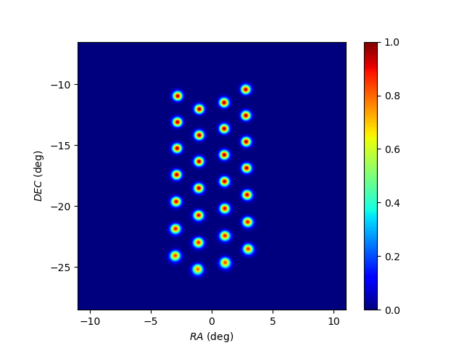
Abdalla, Marins, Mota et al., submitted to A&A

Slide 47
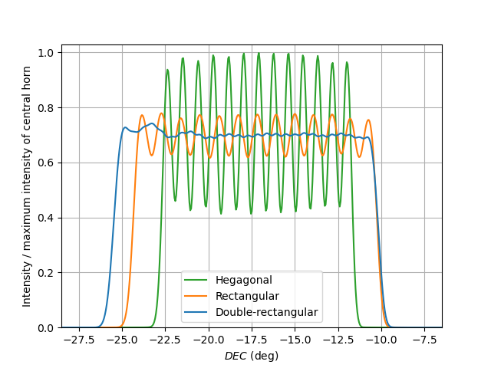
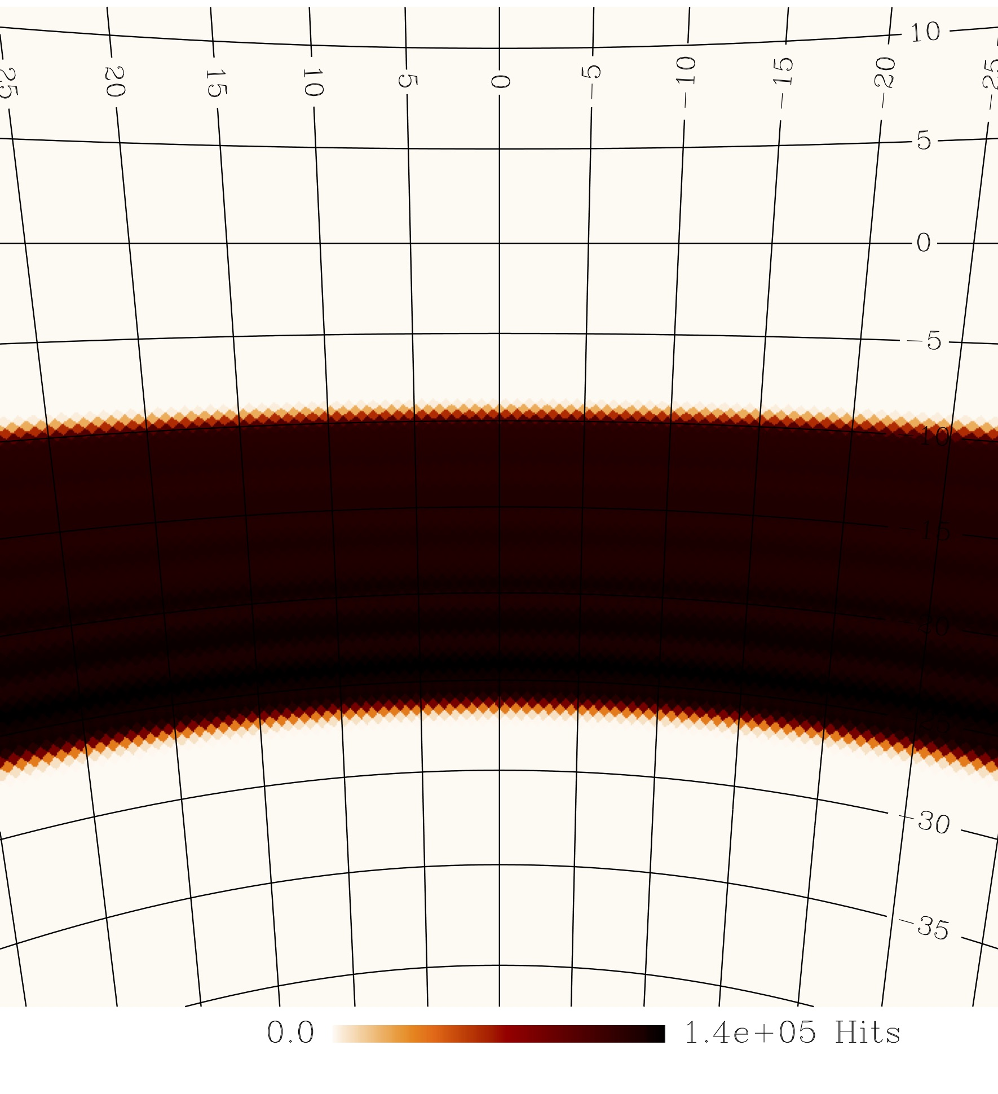
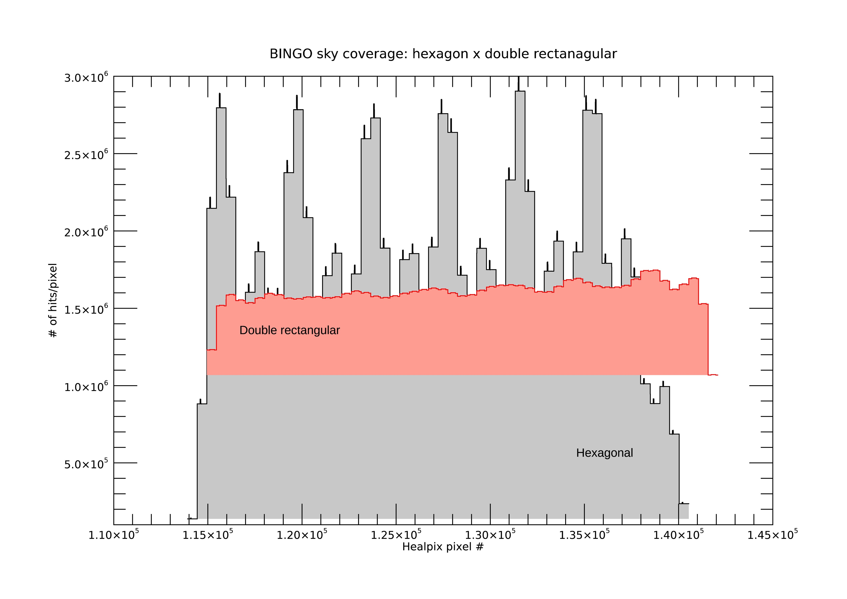
Liccardo et al., submitted to A&A

Slide 48
Data Analysis
Led by F. Abdalla

Slide 49
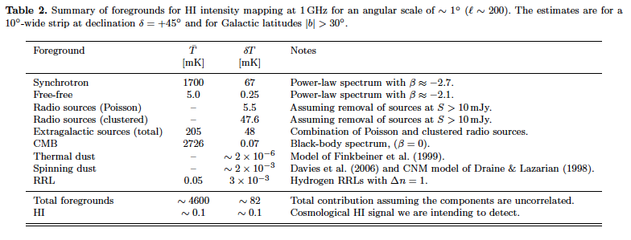
Foreground budget
From Battye et al. (2013), still valid for the current BINGO configuration

Slide 50
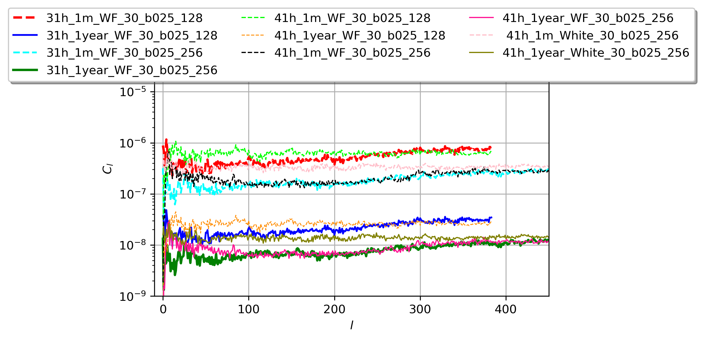
Fornazier et al., in preparation
Liccardo et al., in preparation

Slide 51
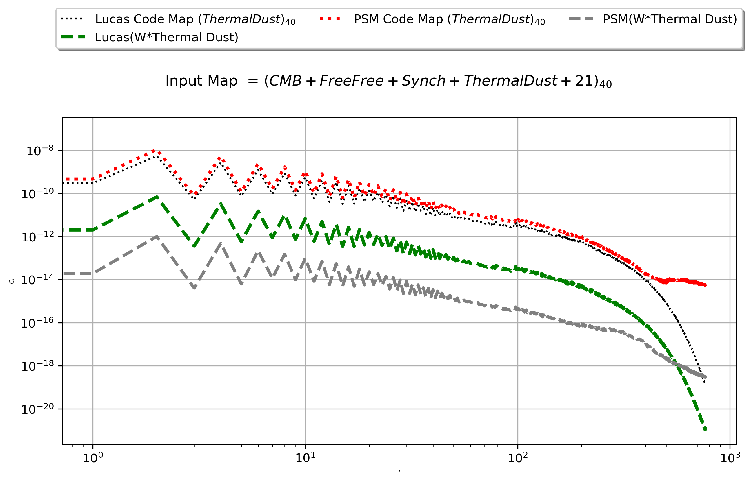
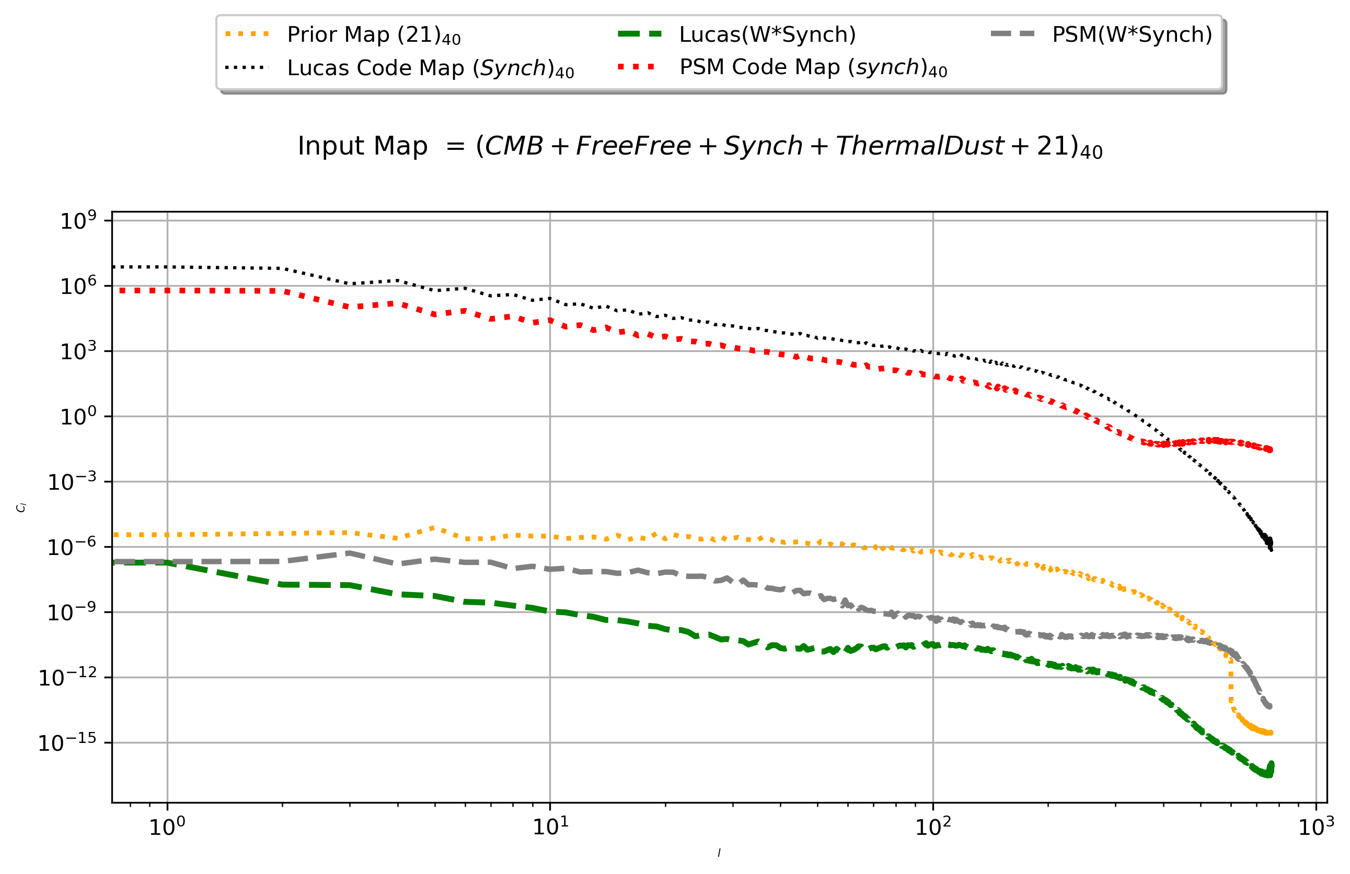
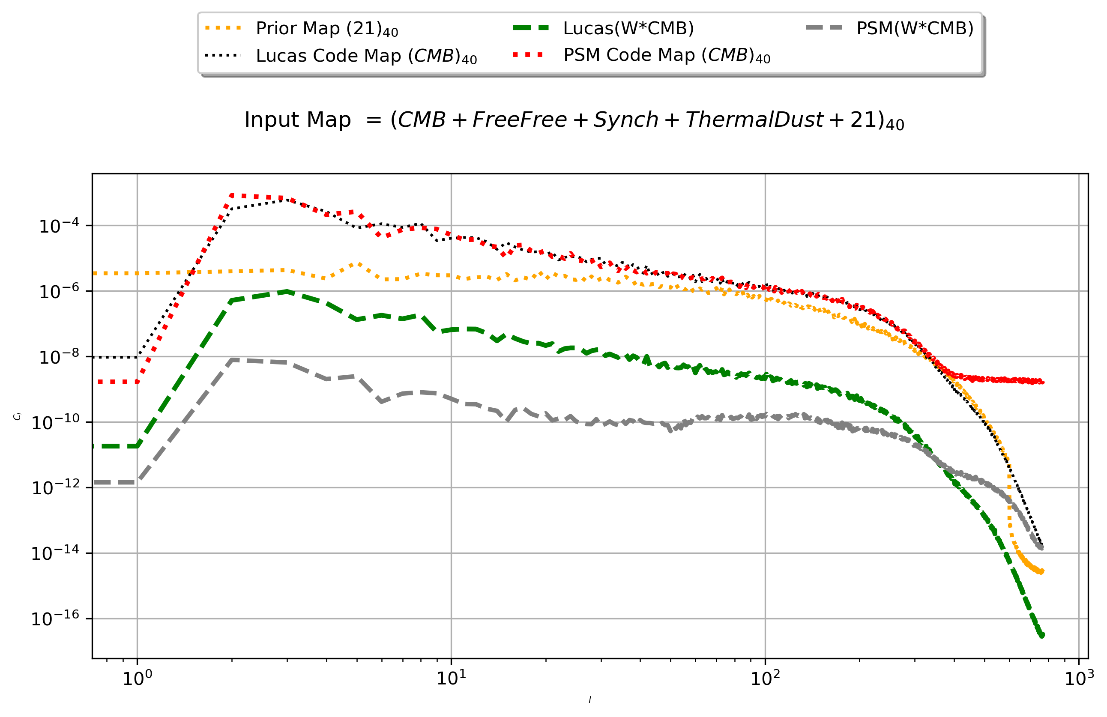
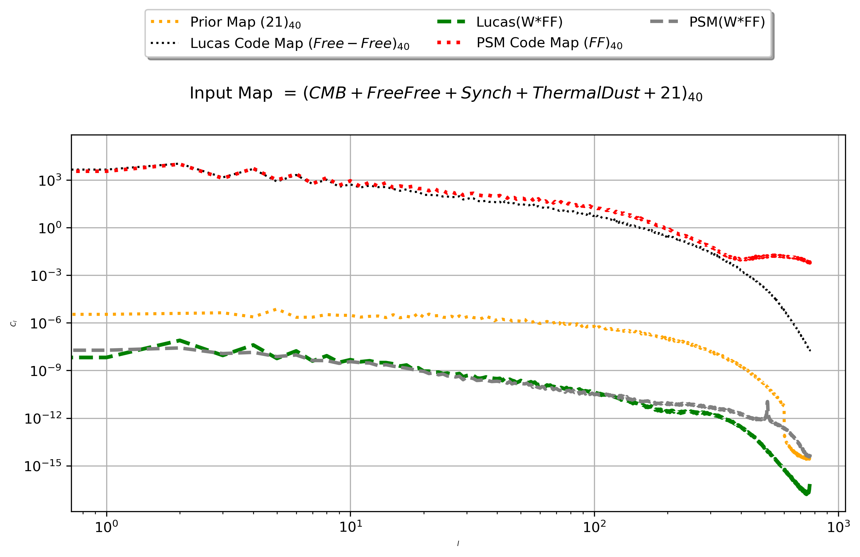
Component separation
From K. Fornazier

Slide 52
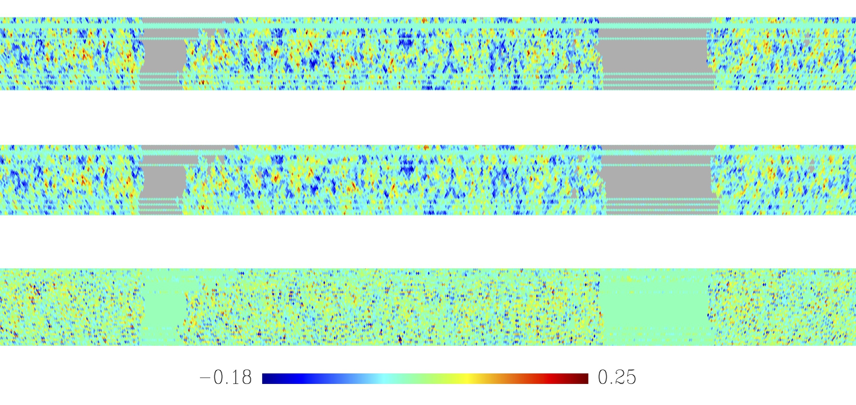
BINGO simulated input map @ 1100 MHz
BINGO reconstructed map @ 1100 MHz
Residuals
mK
From V. Liccardo
Notes:
BINGO \textsc{Hi} plus noise maps with a Galactic mask applied at $\approx$ 1.1 GHz. In the $top$ panel, we have the input map, in the $middle$ panel, the GNILC reconstructed map and in the $bottom$ panel the residuals map (temperatures are given in mK).

Slide 53
Fast Radio Bursts
Led by R. Landim, M . Vargas, A. Queiróz and and F. Vieira

Slide 54
Fast Radio Bursts detection
FRB is not BINGO main science, but serendipitous detections are expected
Outriggers for interferometric pinpoint of the progenitor are being planned
Need ADDITIONAL FUNDING!
M.Sc. thesis from F. Vieira (2020) presented a preliminary analysis performance regarding FRB detections
BINGO
For ~ 3 Jy (max flux density) BINGO will likely see about 1 event every 2.84 days…
Luo et al., arXiv:2003.04848
F. Vieira: estimates for BINGO

Slide 55
RFI Concerns
Led by L. Barosi

Slide 56
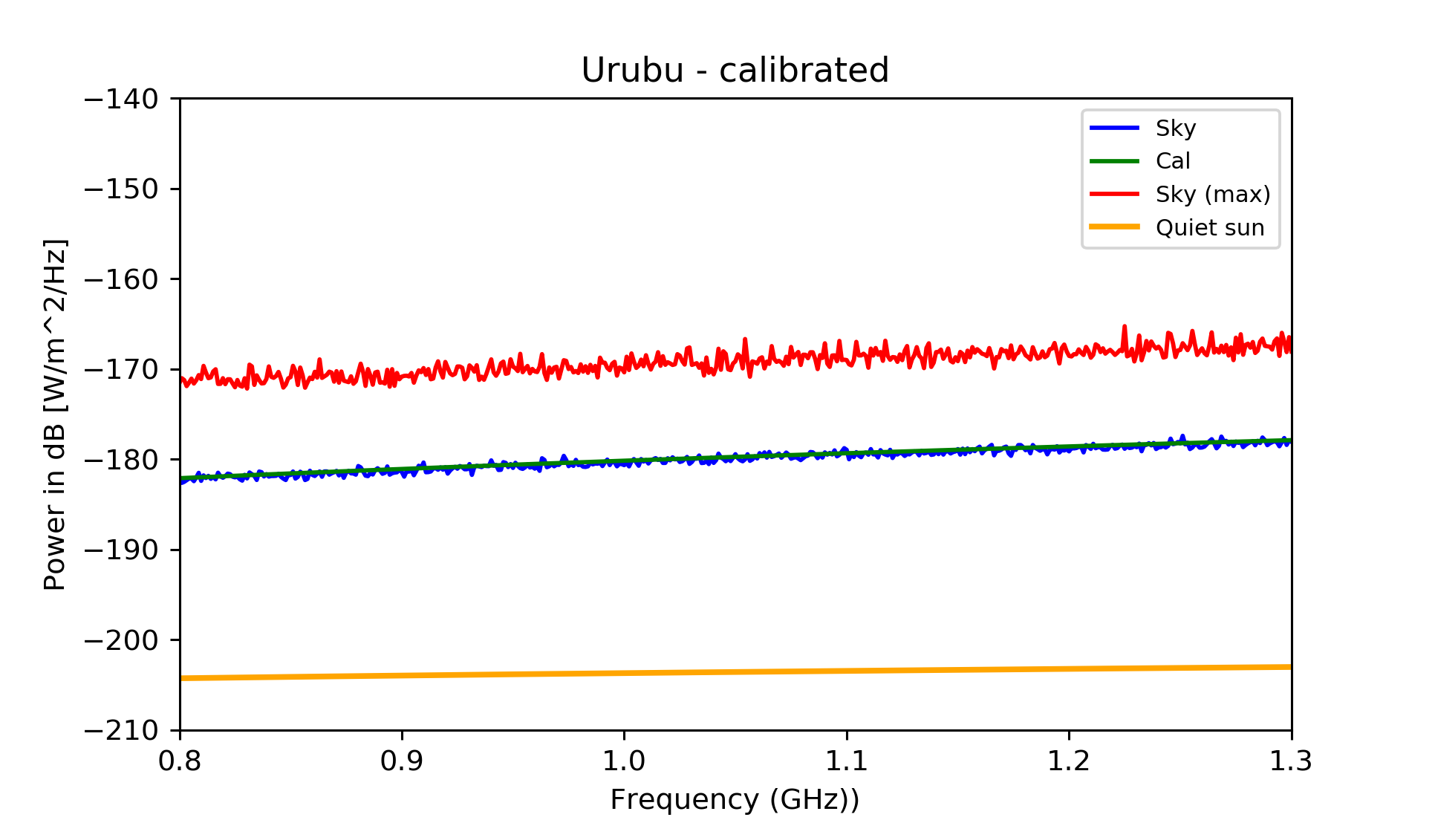
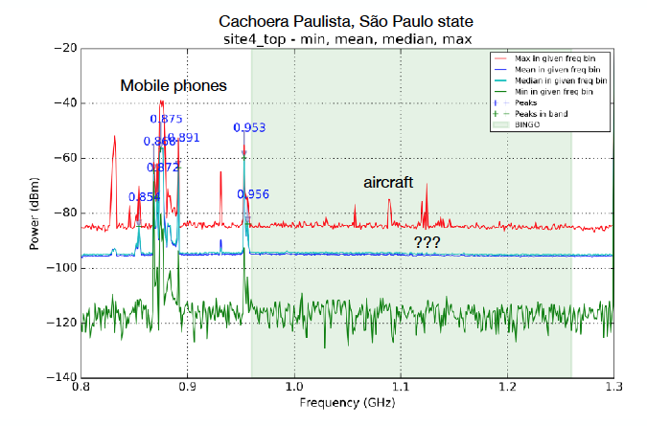
The BINGO site in Paraíba is CLEAN in the radio band

Slide 57
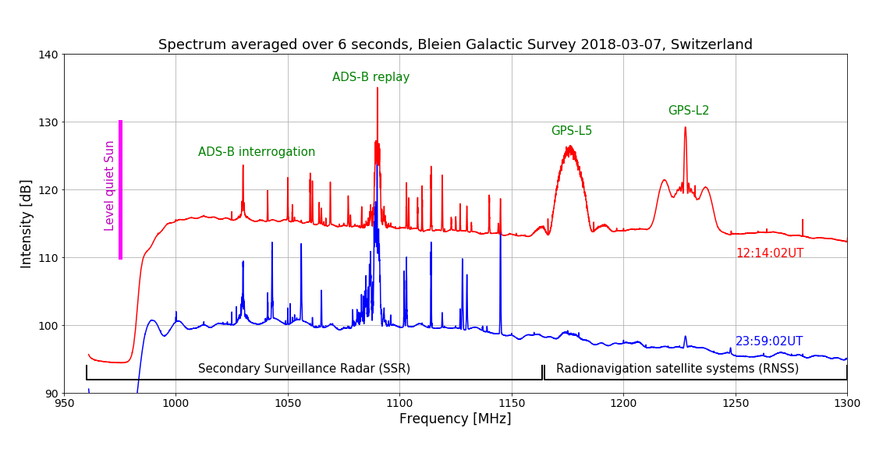
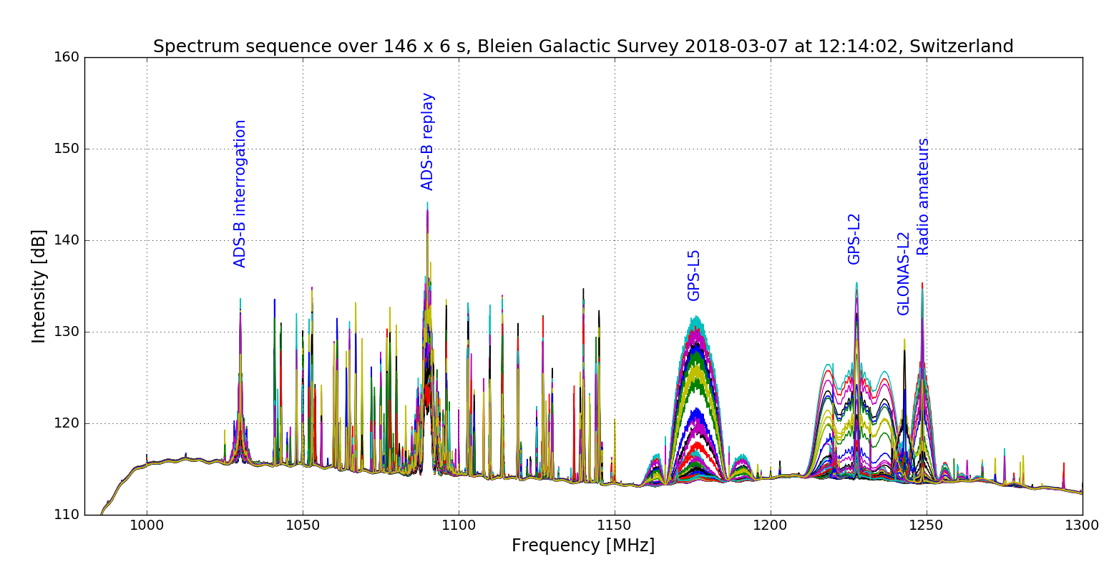
For comparison, the spectrum in the same band in Bleien Observatory (Switzerland)…

Slide 58
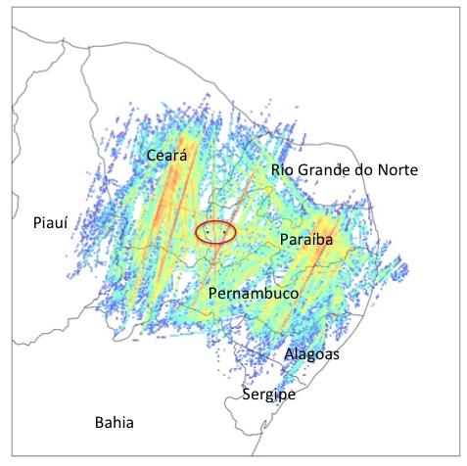
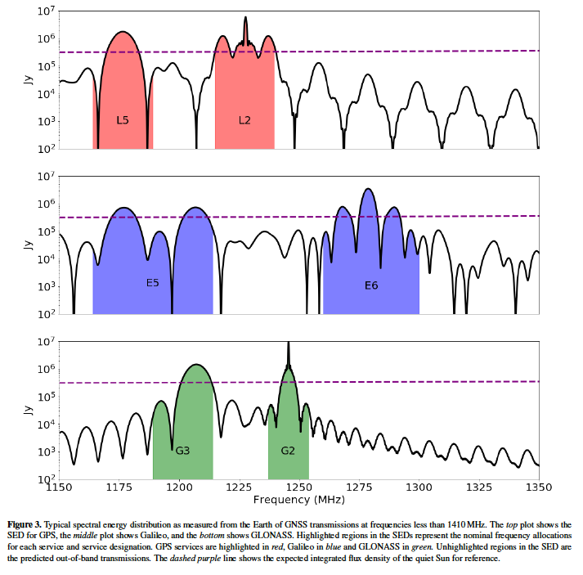
Still, there are concerns about airplane coverage and geostationary satellites…
Peel, Wuensche et al (J. Astr. Instrumentation 2019)
Harper & Dickinson, arXiv:1803.06314v2

Slide 59
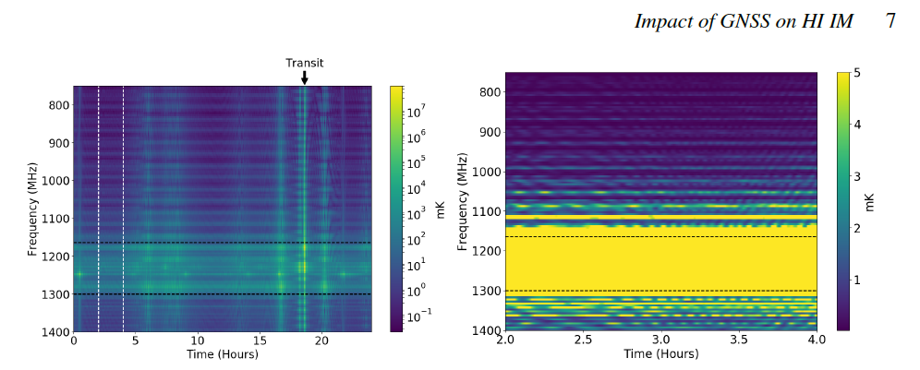
And GNSS…
GNSS in the beam of the telescope
Black dashed lines: L5 (1164 MHz) and
L2 bands (1260 MHz)
White lines: no GNSS closer than 29 deg. of the main be beam axias
Harper & Dickinson, arXiv:1803.06314v2
Yellow band (zoom and scale) to show the off-band leakage of GNNS into the band

Slide 60
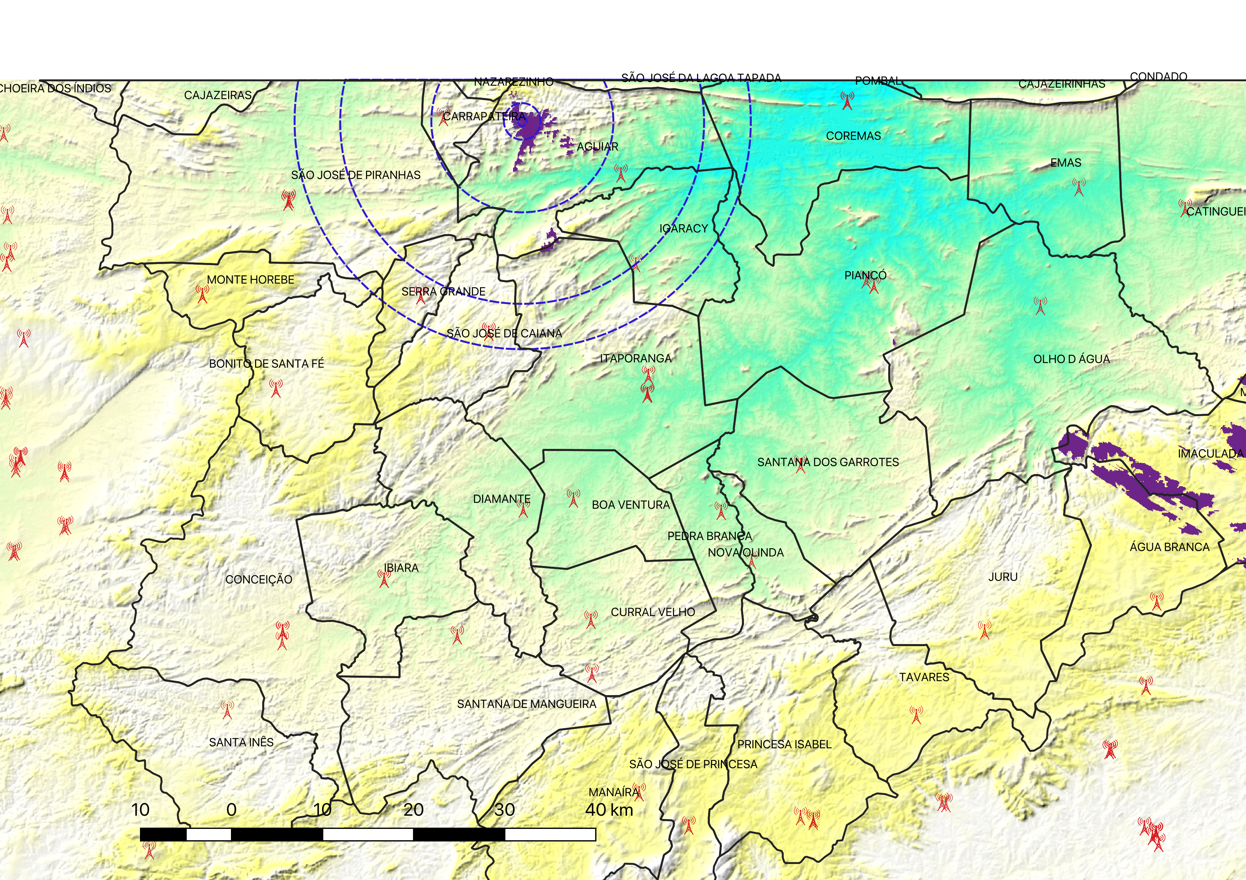
Silence zone proposal (discussions with Anatel started October 2018)
ZONA 1: 500m - Telescope only
ZONA 2: 2km – Industrial activities, power plants (wind or solar), radios, wireless networks, radio repeaters
ZONA 3: 10km – No new ERB (only one now)
ZONA4: 25km – Keep current mobile antennas, new antennas can be installed upon request & approval. No wind or solar plants.
Source: L. Barosi

Slide 62
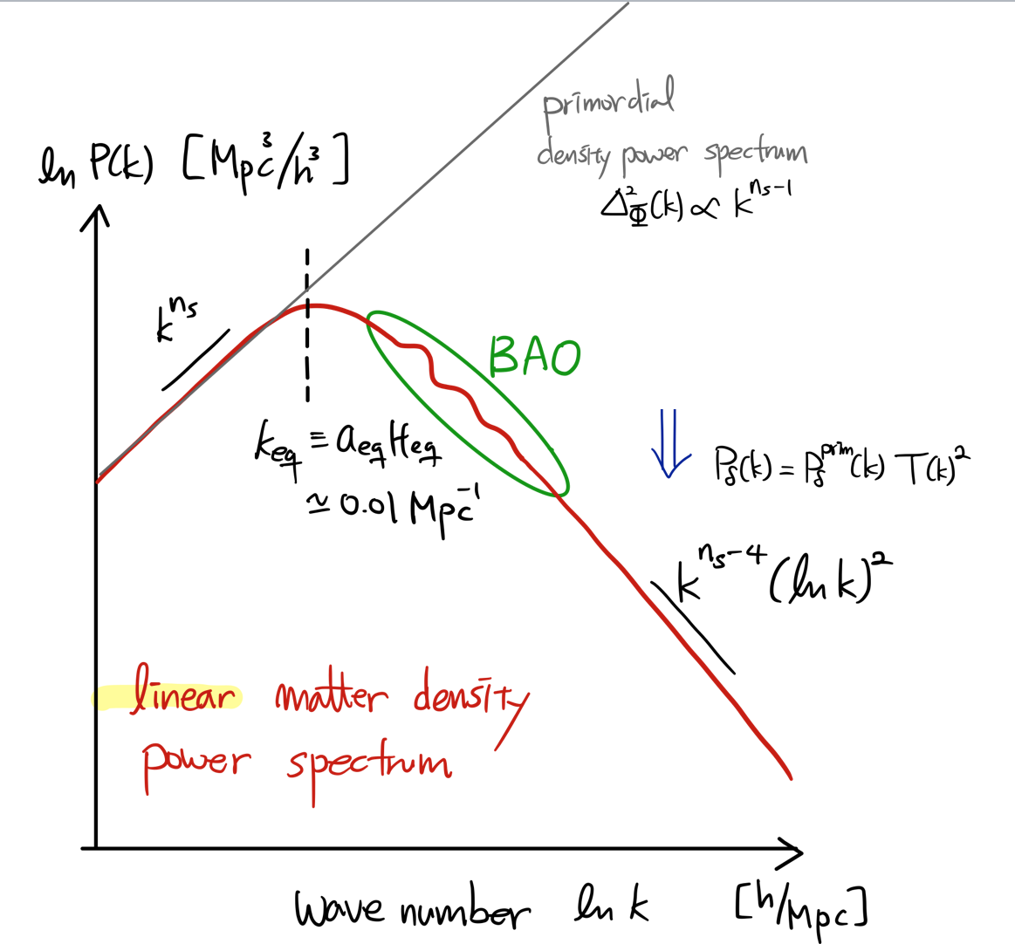
http://www.personal.psu.edu/duj13/ASTRO545/

Slide 63
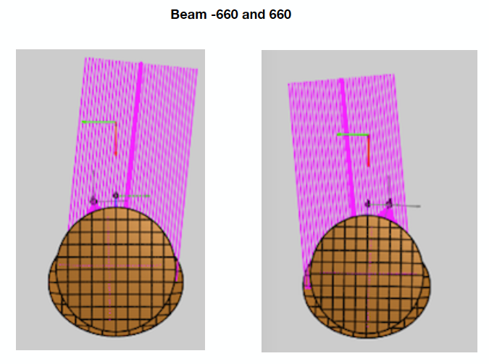
From B. Maffei / I. Ferreira

Slide 64
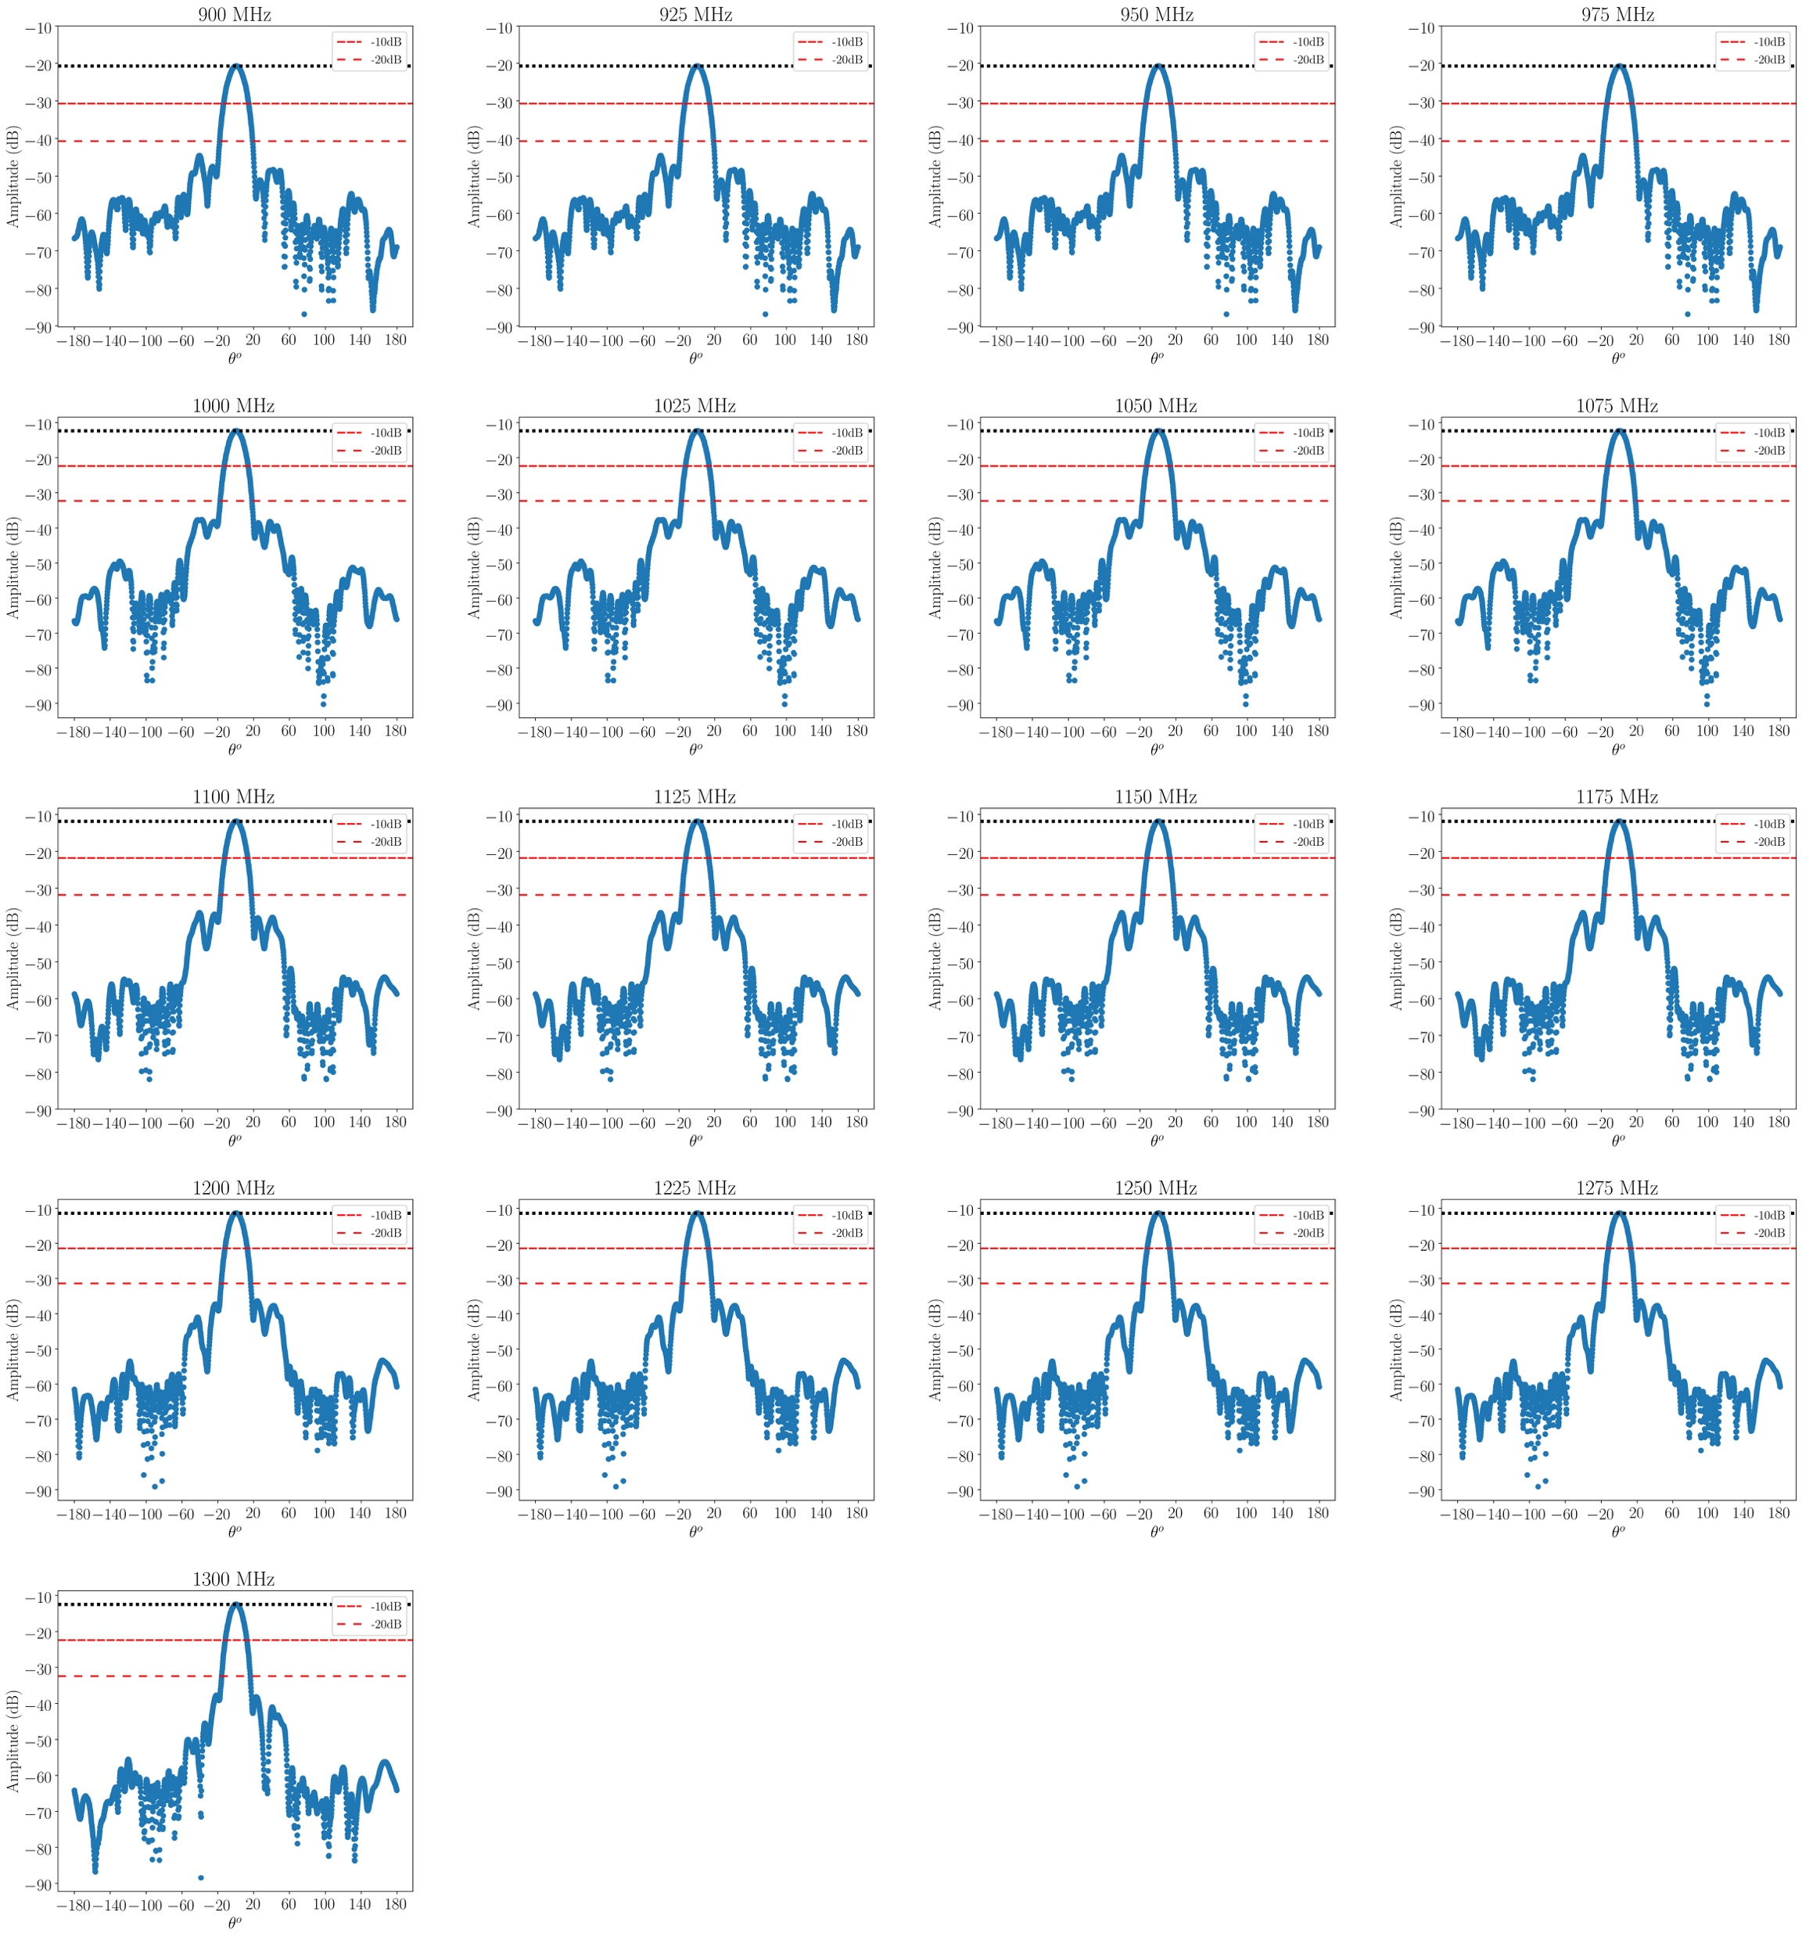
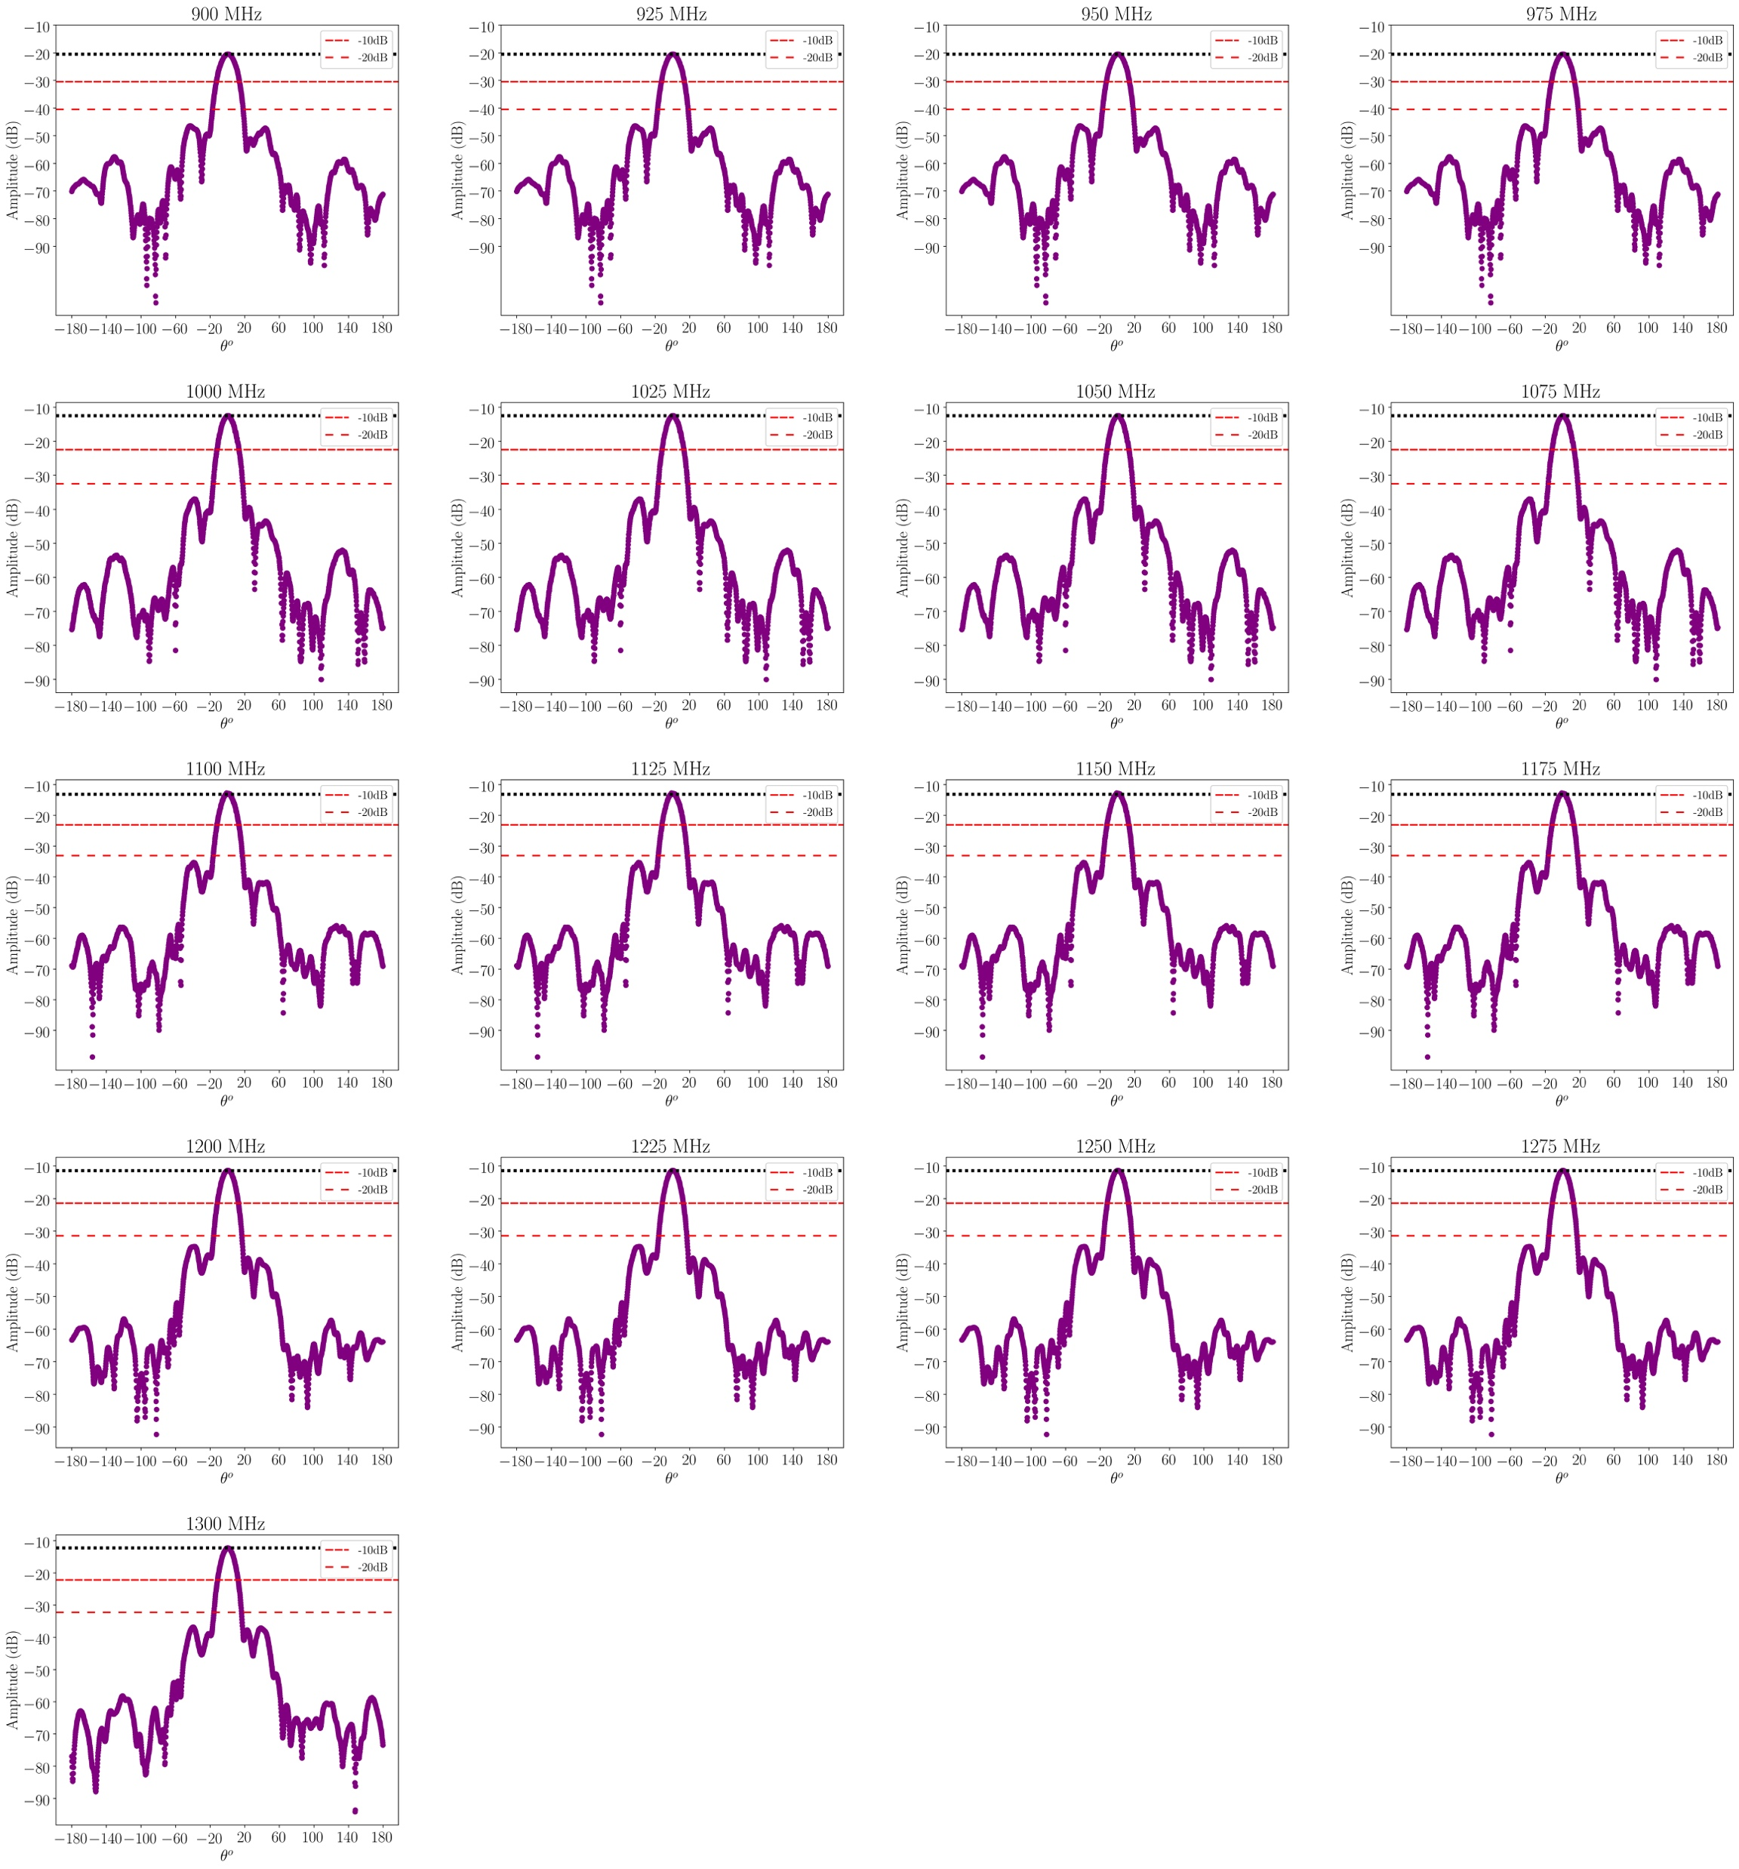
BINGO beams measured @ LIT
Vertical polarization
Horizontal
polarization
Abdalla, Marins, Mota et al., in preparation

Slide 65
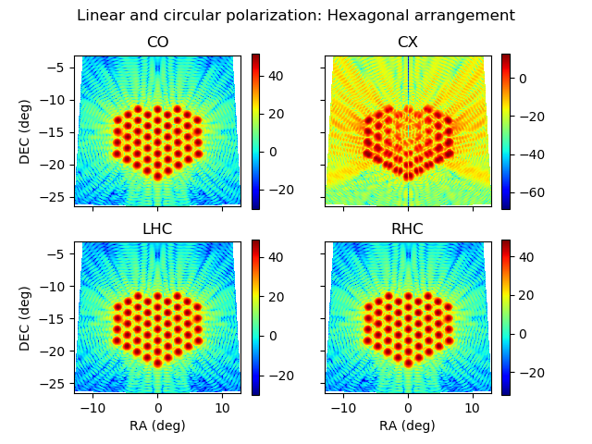
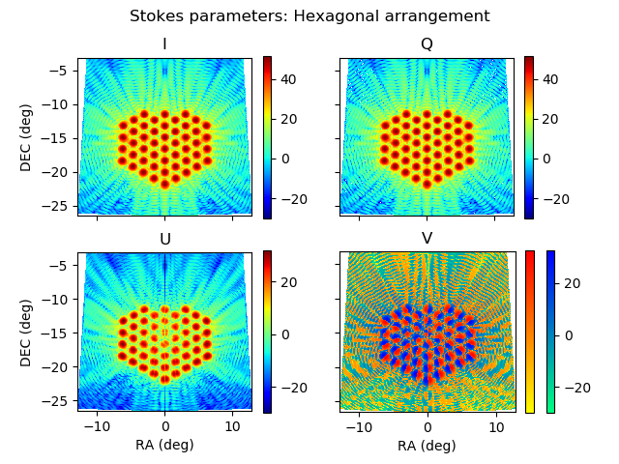

Abdalla, Marins, Mota et al., in preparation

Slide 66


Projeto Arquitetônico – Outubro 2020

Slide 67


Slide 68

Standard Cosmological Model
Observational tests
SN Ia
Weak
Lensing
Geometry of the Universe (k=0)
CMB
Baryon Acoustic Oscillations
Cluster Counting

Slide 69


Slide 70

Peel et al, J. Astron. Instrum. (2019)

Slide 71

Produção:L. Barosi

Slide 72
From A. P. Souza

Slide 73


Slide 74


Slide 75
Projeto Arquitetônico – Outubro 2020

Slide 76


From L. Barosi

